Slide 1


Managing
Organizational
Performance
Brent Stockwell
Strategic Initiatives Director
Scottsdale City Manager’s Office
Bstockwell@ScottsdaleAZ.gov
480-312-7288
Notes:
Good morning – thanks for taking the time out of your busy schedules to think strategically.
Welcome to “Managing Organizational Performance” class where we’ll talk through several of the key habits for increasing the likelihood your organization will be a high-performance organization
We’ll be here until noon., there are several breakpoints when we’re doing group exercises. The restrooms are out the door and to the right down the hall, there’s a break room with vending machines there as well.

Slide 2
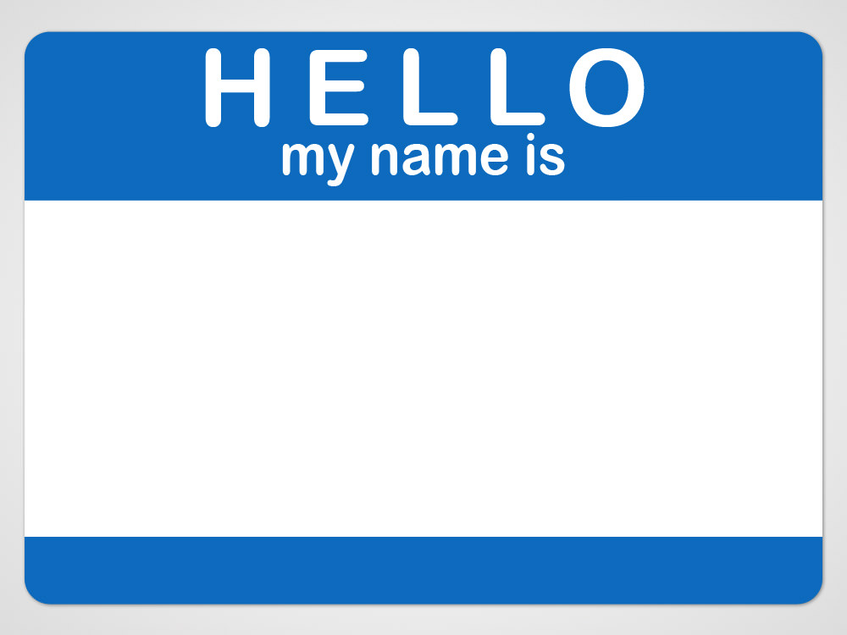
Brent Stockwell
Strategic Initiatives Director
City Manager’s Office
Serving Scottsdale since 2002
Notes:
Hello. My name is Brent Stockwell, and I work in the City Manager’s Office.
I manage special projects for the city manager – whatever he wants me to do –
And I support organization-wide initiatives such as strategic planning and performance measurement.
A key service I provide is consulting and training to the organization
I agreed to teach four sessions of this class this year because I think there’s great value continuing to learn and grow in these subject areas. Teaching forces me to keep thinking intentionally and strategically about these subjects. And hopefully what I have to share is of value to you.

Slide 3
Who are you? What you do?
What’s one key service you provide?
Why did you sign-up for this class?
Notes:
As we get started, let’s take time to get to know each other.
Please answer these questions as we go around the room.
Next?

Slide 4

“..the only measure of a great team – or a great organization – is whether it accomplishes what it sets out to accomplish.”
Patrick Lencioni
Notes:
This class is about providing practical help to a variety of employees wanting to manage performance in their department or division

Slide 5

What should Abigail do?
Notes:
Abigail has just been appointed director of her department. She wants to be successful in this new role and wants to make sure that her department is contributing effectively to the city’s overall efforts.
What should Abigail do?

Slide 6

What should Daniel do?
Notes:
Daniel is an analyst and looking at performance measures in Abigail’s department. He notices that the primary measures are workload measures. What should Daniel do?

Slide 7

What should Emily do?
Notes:
Emily is an employee in Abigail’s department. She wants to be supportive of the performance management effort. What should Emily do?

Slide 8

Tools for success.
Strategic Planning
Logic Models
Performance Measures
Evaluation & Analysis
Reporting
Notes:
Today – I’ll share a number of tools that will help answer these questions – and help you help your organization accomplish what it sets out to accomplish.

Slide 9



    Three reasons employees don’t like their jobs
    From Patrick Lencioni. 2007. “The Three Signs of a Miserable Job.”
      Anonymity
      Irrelevance
      Immeasurability
      We aren’t understood or appreciated for our unique contribution
      We don’t see how our work impacts the lives of others
      We don’t get a daily sense of measurable accomplishment
Notes:
Thanks! Let’s get started.
I love Patrick Lencioni’s book Three Signs of a Miserable Job – has anyone else read it?
In it – he identifies three key reasons employees don’t like their jobs.
The first – anonymity – we aren’t understood or appreciated for what we do;
the second – relevance– we don’t see how our work impacts others; and
third – immeasurability – at the end of each day, we don’t know how much we accomplished
In the book he suggests some tools for making jobs less miserable
The concepts in this book make a lot of sense to me and I began thinking about the impacts on multiple levels

Slide 10
    Three reasons employees don’t like their jobs
    From Patrick Lencioni. 2007. “The Three Signs of a Miserable Job.”
      Anonymity
      Irrelevance
      Immeasurability
But, what if…
we understood our unique contribution,
knew how our work impacted others
and got a daily sense of accomplishment?
Wouldn’t that make a difference?
Notes:
As employees – our job satisfaction would improve if we understood our unique contribution, how our work impacted others, and if we got a daily sense of accomplishment

Slide 11
    Three reasons employees don’t like their jobs
    From Patrick Lencioni. 2007. “The Three Signs of a Miserable Job.”
      Anonymity
      Irrelevance
      Immeasurability
This is true for organizations as well.
What if…
we clearly communicated what we do,
why we do it,
and how well we do it?
Wouldn’t that make a difference?
Notes:
This is also true from the organization perspective as well –
if we could clearly communicate what we do, that would reduce organizational anonymity; why we do it - would reduce organizational irrelevance; and how well we do it - would reduce organizational immeasurability
And –would result in a stronger self-image of organizational performance
It’s clear to me. Effective organizations have a clear sense of what they do, why they do it, and how well they do it.

Slide 12
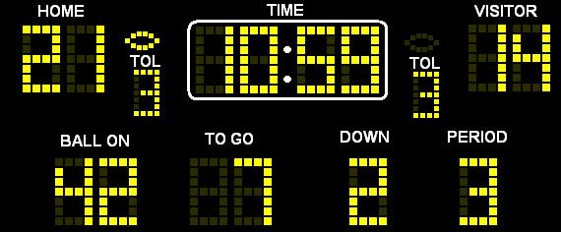
Notes:
This class is about managing organizational performance. And organizations consist of people. People need to be managed, and an important part is coaching and motivating towards improved performance.
Without measurement, without feedback on our performance, without an end goal in mind – it’s very hard to motivate people.
Imagine going to a football game and looking up and seeing the scoreboard. You can tell exactly what’s going on – if you’re a football fan – you can probably visualize exactly what’s going on in your mind’s eye,
But what if… the scoreboard wasn’t there!

Slide 13
    “Imagine playing or watching a football game and not knowing the score.”
    Patrick Lencioni
Notes:
The author, Patrick Lencioni, says it this way –
“Well, if a person has no way of knowing if they’re doing a good job, even if they’re doing something they love, they get frustrated. Imagine playing a football game and not knowing the score. Or being a broker and not knowing if the price went up or down after you bought a stock… Whether you’re a doctor, a lawyer, a janitor, or a game show host, if you don’t get a daily sense of measurable accomplishment, you go home at night wondering if your day was worthwhile.”
It’s clear -- we need feedback on our performance: “objective evidence that tells you’re doing
something right.”

Slide 14
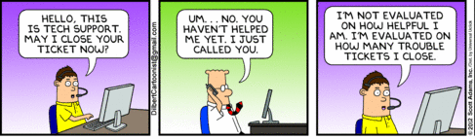
      “The key is always to measure the right things.”
      Patrick Lencioni
Notes:
But you always have to be very careful about what you focus on.
As Patrick Lencioni wrote – “the key is always to measure the right things.”

Slide 15

“What matters is not finding the perfect indicator, but settling upon a consistent and intelligent method of assessing your output results and then tracking your trajectory with rigor.”
Jim Collins
Notes:
So, The key concept that we’re trying to stress is “evidence-based decision making”
Make decisions about evidence we’ve collected, rather than assumptions or even well-educated guesses
Jim Collins – author of Good to Great had this to say about these types of efforts
“To through our hands up and say “we cannot measure performance the way you can in a business” – is simply lack of discipline.
He goes on to say that all measures are flawed to some degree
Test scores are flawed, mammograms are flawed, crime data are flawed, customer service data are flawed, patient outcome data are flawed.
“What matters is not finding the perfect indicator, but settling upon a consistent and intelligent method of assessing your output results and then tracking your trajectory with rigor.”

Slide 16
Performance management is…
…an organization-wide effort
to improve results
by integrating objective evidence with decision-making processes
Notes:
So what matters is finding a consistent and intelligent method, then rigorously assembling evidence and tracking progress
When we measure, we can monitor & evaluate performance of services we provide & staff that provide those services
In the end, measuring facilitates learning, informs decision-making and leads to improved performance and results
So the definition we use for organizational performance measurement is on the screen – it’s an effort to “improve results by integrating objective evidence with decision-making processes.”

Slide 17
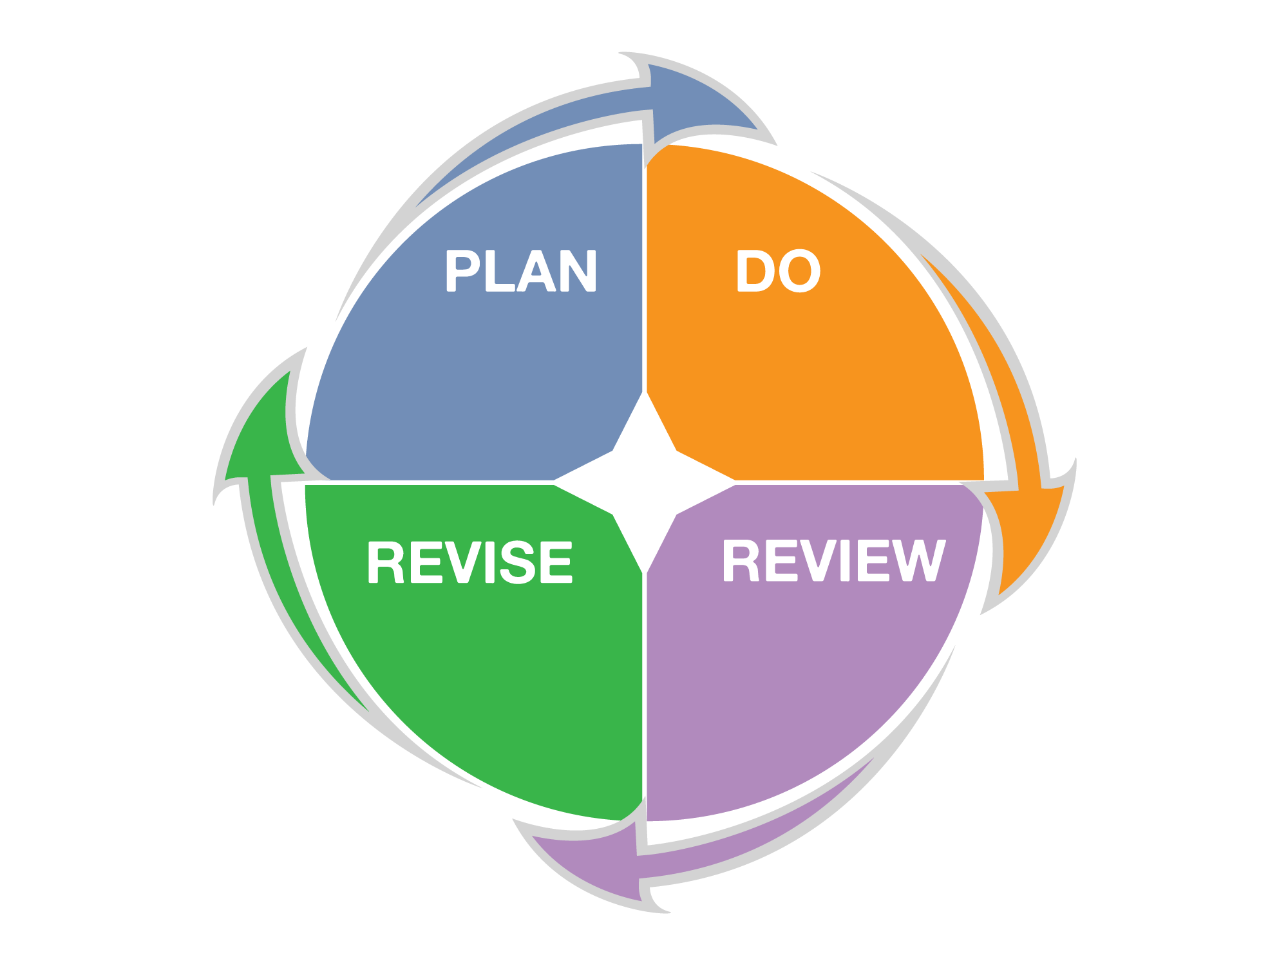
Performance Management
Process
What are you
trying to achieve?
What must you do to achieve your desired results?
What must you improve to achieve your desired results?
How will you know if you are successful?
Notes:
Like many things in life and at work – performance management is a cycle. A process that repeats over and over.

Slide 18
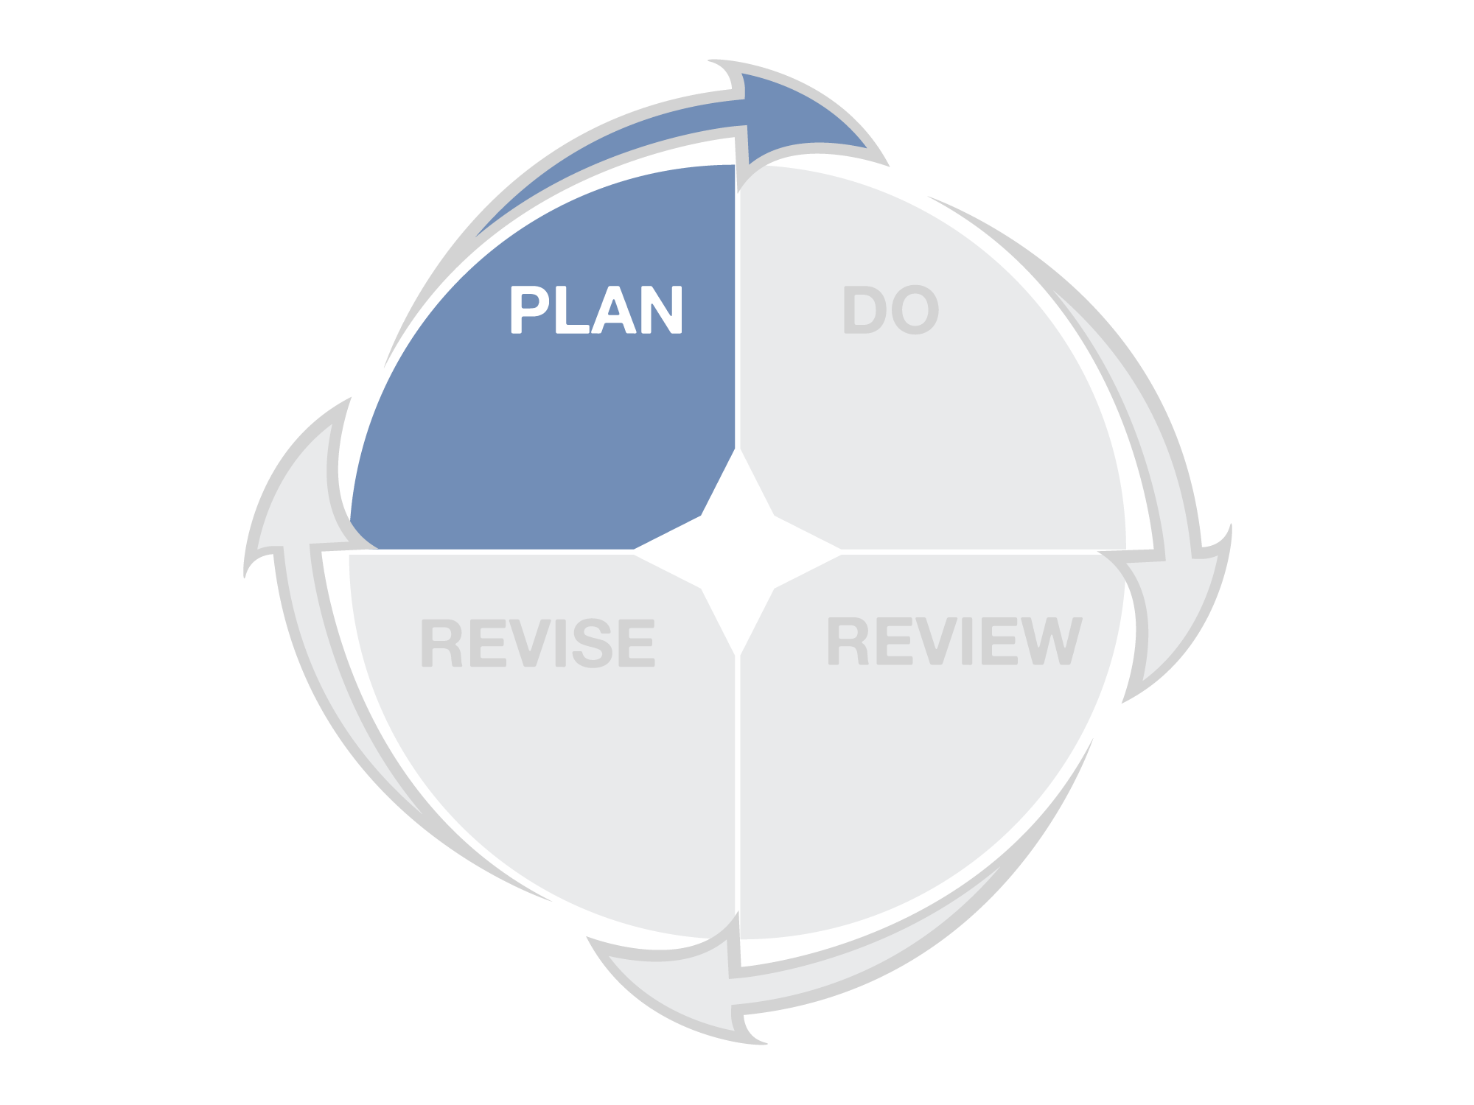
What are you
trying to achieve?
Notes:
First – PLAN answers the key question – what are you trying to achieve?
This helps align our efforts – the services we deliver – with established mission and goals of our organization

Slide 19
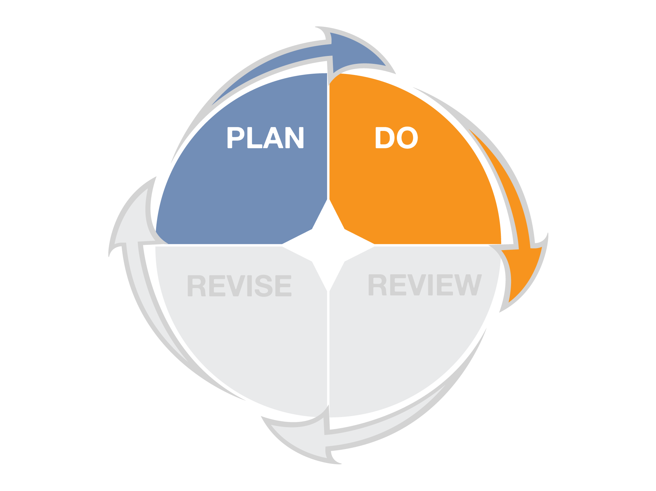
What must you do to achieve your desired results?
Notes:
The second – DO – answers – what must you do to achieve your desired results?
This is to understand different types of measures and select appropriate ones to track efficiency and effectiveness

Slide 20
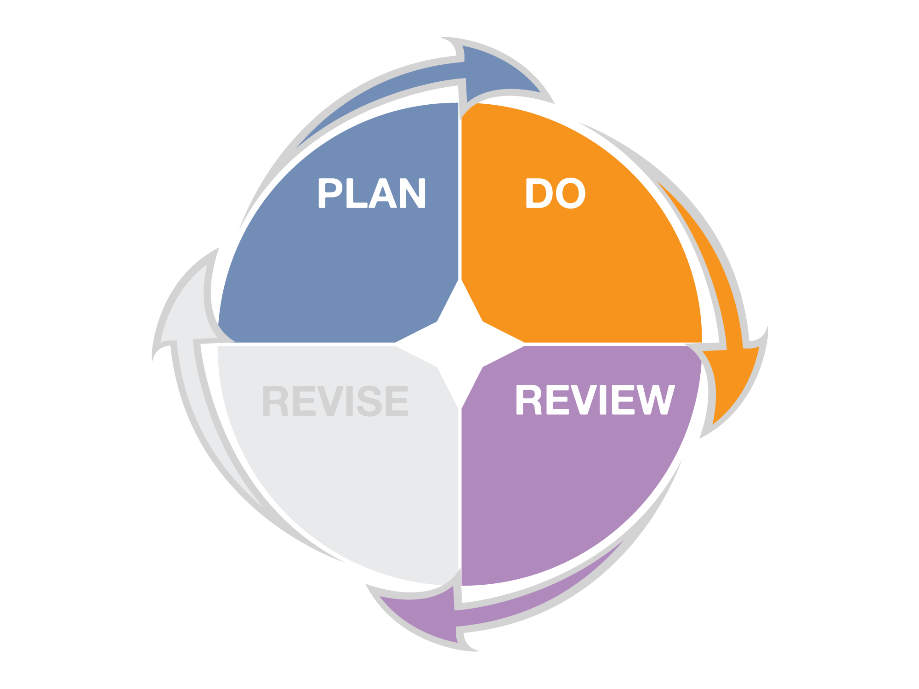
How will you know if you are successful?
Notes:
Third –
Review - How will you know if you are successful?
use evaluation tools to gain understanding about the results we’ve achieved

Slide 21
What must you improve to achieve your desired results?
Notes:
Fourth –
What must you improve to achieve your desired results?
when performance is below par – a method to make improvements
And the cycle repeats over and over.
This tool is helpful to explain that performance management is not a one-time activity.

Slide 22
Planning for Performance
What are you
trying to achieve?
Notes:
So the first section is on planning – and the key question is “what are you trying to achieve.”

Slide 23
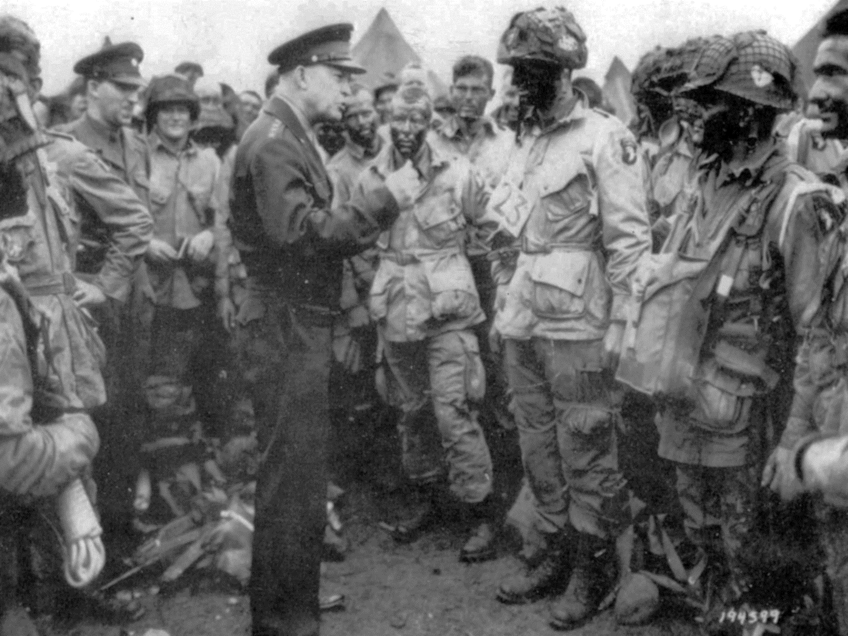
“Plans are worthless, planning is everything.”
Dwight D. Eisenhower
Notes:
Dwight D. Eisenhower – five-star general and president of the United States had this to say about planning efforts: ”Plans are worthless, but planning is everything. There is a very great distinction because when you are planning for an emergency you must start with this one thing: the very definition of "emergency" is that it is unexpected, therefore it is not going to happen the way you are planning.”
What’s true in an emergency is true in business as well – things rarely go as planned –
But the exercise of planning – of systematically thinking through what might be done and how it might be achieved – is critical to success. It helps with preparedness – which greatly increases the chance of success even when things don’t go as planned.

Slide 24

Some strategic plans are nothing
more than…
__________
    Robert McCall, Arizona 2010
    Scottsdale Public Art Collection
Notes:
Any suggestions on how to fill in this blank?
Wishful thinking? Dust collectors? Hopes and dreams?
Unfortunately this is true. Just like this futuristic painting of Arizona in 2010, which we know is not reality!
I would suggest that much of this is due to not integrating objective data into these processes.
So let’s talk about how to improve our strategic planning efforts.

Slide 25

What is a Strategic Planning?
A management tool to:
assess the current environment
anticipate and respond to change
envision the future
increase effectiveness
develop commitment to the mission
achieve consensus on objectives
GFOA Best Practices (2005)
Notes:
The Government Finance Officers Association published a “best practices” paper in 2005.
They defined strategic planning this way:
Strategic planning is about influencing the future rather than simply preparing or adapting to it.
The focus is on aligning organizational resources to bridge the gap between present conditions and the desired future.

Slide 26
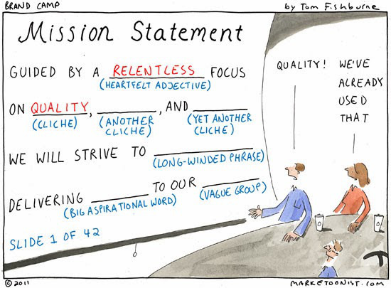
Prepare a mission statement
Notes:
The first step is to prepare or revise a mission statement –
But not this way!

Slide 27
In contrast, good mission statements:
Are short and sharply focused
State why we do what we do
Provide direction for doing the right things
Are clear and easily understood
Are memorable and easily memorizable
Describe what we want to be remembered for
Prepare a mission statement
Notes:
The mission statement should be a broad but clear statement of purpose for the entire organization.
One of the critical uses of a mission statement is to help an organization decide what it should do and, importantly, what it should not be doing.
The organization’s goals, strategies, programs and activities should logically cascade from the mission statement.
These criteria on the screen are taking from Peter Drucker’s book, The Five Most Important Questions You Will Ever Ask About your Organization.

Slide 28

“The effective mission statement is short and sharply focused. It should fit on a t-shirt.”
Peter Drucker
Notes:
A lot of times you’ll see organization mission statements where they try to fit everything in – they don’t want to leave anyone or anything out.
But Peter Drucker said – the effective mission statement is short and sharply focused. It should fit on a t-shirt.”

Slide 29
The mission of the City of Scottsdale is to cultivate citizen trust by fostering and practicing open, accountable, and responsive government; providing quality core services; promoting long-term prosperity; planning and managing growth in harmony with the city’s unique heritage and desert surroundings; strengthening the city’s standing as a preeminent destination for tourism; and promoting livability by enhancing and protecting neighborhoods. Quality of life shall be the city’s paramount consideration.
Notes:
No – not like this t-shirt.

Slide 30

Notes:
We kept these criteria in mind when the City Council revised our mission statement last year.

Slide 31

Simply better service for a world-class community
What does this mean to you
as an employee?
What might you do, or not do,
as a result of this mission statement?
Notes:
So let’s stop for a minute –
I’m interested in your feedback.
Here’s our mission statement. Take a look at it for a moment and jot down on the paper your gut responses to this question –
What does this mean to you as an employee?
And also –
Thinking about the work that you do – what actions might you take, or not take, as a result of this mission statement?
Let’s share some of our responses.

Slide 32
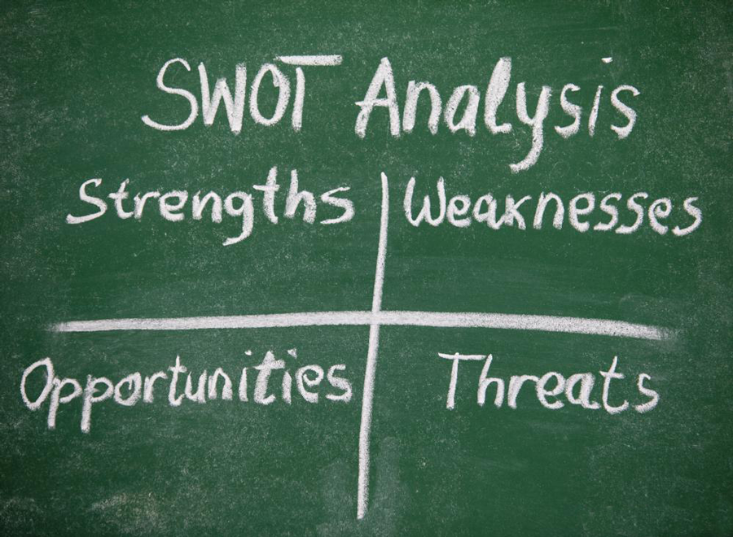
Assess environmental factors
Notes:
After the mission statement – the next step is to assess environmental factors.
This is a thorough analysis of the government’s internal and external environment.
A frequently used methodology for conducting an environmental assessment is a “SWOT” (Strengths, Weaknesses, Opportunities, Threats) analysis.
Strengths and weaknesses relate to the internal environment, while
analysis of opportunities and threats focuses on the environment external to the organization
Also, you should identify key stakeholder concerns, needs, and priorities.
You can use individual and large group meetings, surveys, and workshops to do this.

Slide 33

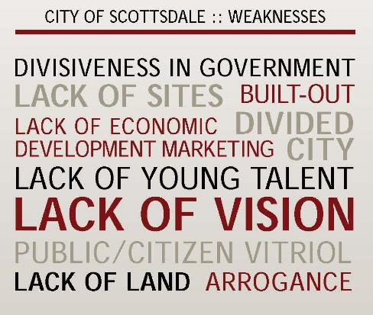

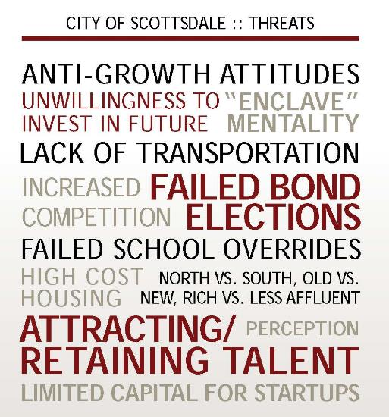
From draft Economic Development Strategic Framework
Notes:
Here’s an example of a SWOT analysis that was put together following extensive stakeholder interviews by a consultant hired to put together the city’s economic development strategic framework

Slide 34

Identify critical issues and areas for focus
Notes:
The next step is to identify critical issues and areas for focus.
Use the information from the environmental analysis to identify the most critical issues.
This should reflect stakeholder or customer concerns, needs, and priorities as well.

Slide 35
Climate / Weather
Green Space
Outdoor Access
Body of Water
Churches
Architecture
“Third Place”
Outdoor Public Art
Historical Monuments/Sights
Museums/Galleries
Venues
Concentration
Social Capital
Beauty at Night
Seasonal Appeal
Manageable Size
Sufficient Diversity
Natural Assets
Economics
Environment/ Sustainability
Other
Cultural Assets
Specific Amenities
People
Technology/ Innovation
Public Services
World-Class Community
Hotel Options
Restaurants / Cafes / Bars
Classical Music
Characteristic Souvenirs
Shopping Options
Air and Water Quality
Peace and Quiet
Quality of Life
Quality of Place
Livability
Healthcare
Public Transportation
Stability
K-12 Education
Pedestrian Friendliness
Urban Design
Public Restrooms
Safety / Crime
Cleanliness (Garbage, Street)
Wireless Availability / Coverage
Free Attractions
Proactive Policy Development
Talent (Education)
Creativity/Bohemia
Tolerance / Openness
Social Diversity
Attractiveness
Good Drivers
Professional / Amateur Sports
Cultural Events
Nightlife
Street Performers
Cost of Living
Employment
Economic Growth
Wage Growth
Corporate Tax
Personal Tax
Tech Leadership
Legend
Category
Referred more than 7 times
Attribute
Referred 4 to 6 times
Notes:
For example –
This is a chart of all the possible attributes of world-class communities that were identified through research.

Slide 36
Plot of 14 Attributes
High
Priority
Ecological Quality
Safety
Transport
Cultural Assets
Natural Assets
Beauty at Night
Social Brand
Influenceable
Specific Amenities
Tech
Leadership
Human Capital
Lively People
Employment
Healthcare
Low
Inclusiveness
Low
High
Alignment with Strategic Goals
Notes:
On the screen is a prioritization that was done as part of our world-class communities effort – as you can see there are 13 different priority areas that were developed as possibilities – and these were analyzed based on their alignment with the strategic goals of the organization and their influenceability by the organization.
Tools like this can be used to identify critical areas.

Slide 37

“Goals make it absolutely clear where you will concentrate resources for results – the mark of an organization serious about success.”
Peter Drucker
Agree on a small number of broad goals
Notes:
Next – based on the priorities, agree on a small number of broad goals
These written goals should address the most critical issues facing the organization or your community.
It may be necessary to define priorities among goals to improve their usefulness in allocating resources

Slide 38

“The hunter who chases two rabbits catches neither.”
Notes:
The important thing is to focus – choose wisely – achieve what you set out to achieve – and then set new goals.

Slide 39

39
Goals:
Are overarching
Should be few in number (5 or less)
Flow from the mission
Build on strengths
Address opportunities
Collectively outline your desired future
Notes:
Here are some criteria that Peter Drucker identified for successful goals –
I think the key is that they should be few in number – 5 or less – others would say 3 or less.
Get those done and then go through the process again – too many goals decrease the likelihood of success – we’ll revisit that point again later.

Slide 40
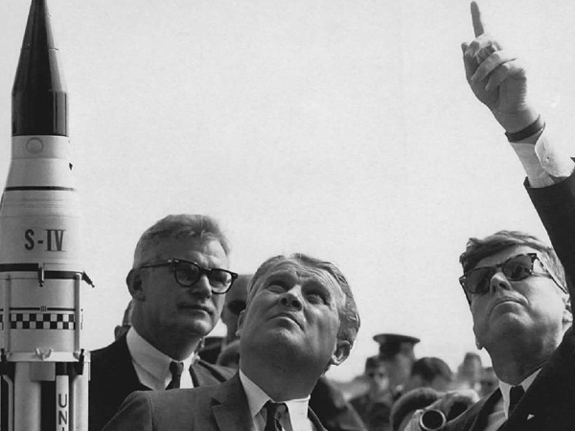
Land a man on the moon
and return him safely to earth
by the end of this decade
from x to y by when
Notes:
Good goals – and their supporting objectives - must be measurable
Here’s the gold standard:
On May 25, 1961, President John F. Kennedy pledged that America would land a man on the moon by the end of the decade. On July 20, 1969, that dream came true.
Chris McChesney – in the book the Four Disciplines of Execution – describes the formula for good goals this way – from x to y by when – land a man on the moon, return him safely to earth – by the end of this decade.

Slide 41

    Decide what you’re trying to accomplish
    Ask yourself these two questions:
    How will you know whether or not you’re making progress?
    How will you persuade someone else you’re right?
    From Robert Lewis. 2009. “No metrics? Don’t fret; you can still manage without measuring.” Minneapolis St. Paul Business Journal.
Notes:
Thinking about this from a different perspective
I was given this article a couple of years ago – and I thought it made some good points that have been incorporated in the presentation today. You’ll see the impact of this over and over.
This is the core of the “why” behind performance measurement and management.
First - Decide what you’re trying to accomplish
Ask yourself these two questions:
How will you know whether or not you’re making progress?
How will you persuade someone else you’re right?
That’s the essence of good goal setting.
I thought the last question was critical – and one we don’t always think about – but this can greatly increase the likelihood of success
If you’re trying to save or change lives – find a way to measure that
Don’t just measure how many reports were written or calls you took!

Slide 42
Develop strategies to achieve broad goals
Customer
  Financial
  Process
  Growth
Notes:
The next step is to develop strategies to achieve broad goals.
Here are four broad categories for strategy development – you might recognize these if you’re familiar with the balanced scorecard approach developed by Kaplan and Norton.
These are four fundamental lenses or perspective through which to view your organziation.
They are four buckets within which most strategies fall –
The first one is financial – what might we do to improve our financial sustainability or profitability - strategies focused on dollars and cents and considering the perspective of our tax/ratepayers and investors/rating agencies
The second is customer focused – can we improve service to our customers, can we increase our number of customers – what might we do to improve satisfaction from the customer perspective
The third is internally focused – what processes must we excel at in order to be successful – this is the internal or process perspective
Fourth – what might we do to continue to improve and create value. This includes strategies focused on growth, innovation and learning
We can consider strategies in each of these areas.

Slide 43
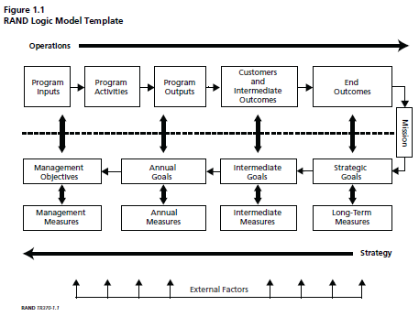
What is a logic model?
Source: http://www.rand.org/content/dam/rand/pubs/technical_reports/2006/RAND_TR370.pdf
Notes:
So thinking more about strategies –
Strategies relate to ways that the environment can be influenced to meet broad goals.
Use of logic models or strategy mapping is encouraged in the design of strategies.
This is the boiler plate logic model developed by the RAND Corporation – a think tank for policy ideas and analysis
As I studied this – I found it to difficult for most organizational applications – so I took the principles and streamlined it for use in our organization.

Slide 44

TO ACHIEVE RESULTS
TO BENEFIT CUSTOMERS
TO DELIVER SERVICES
TO CONDUCT ACTIVITIES
WE USE RESOURCES
Notes:
So I created this tool – out of the need to help people understand the relationship between the resources they have – people and money – and the achievement of results.
The logic model, or strategy model, or outcome model helps us ensure that what we do is aligned with the organization’s goals
The strategy model, or logic model, states how the resources we use logically end up in the goal we’re trying to achieve
So, imagine you’re going on a journey. You’ve picked a destination, you have a vehicle, and you’ve filled it with gas
You use these resources, to conduct activities, to deliver services
To benefit customers, to achieve results (also called outcomes) – typically in support of an organizational goal
This demonstrates relationship between resources (inputs), activities, and services (outputs) with desired results (outcomes)
And all these steps in the model can be measured!

Slide 45

TO ENCOURAGE A CLEAN, SUSTAINABLE ENVIRONMENT
FROM EVERY RESIDENT’S CURB OR ALLEY
TO COLLECT REFUSE AND RECYCLING
DRIVE TO EACH HOUSE TWICE A WEEK
DRIVERS AND TRUCKS
Notes:
Let me run through a couple of examples.
This is the first of many examples using trash and recycling collections as an example
They use drivers and trucks, to drive to each house twice a week, to collect refuse and recycling
From every resident’s curb or alley; to encourage a clean, sustainable environment
Let’s look at this – can you measure each step?

Slide 46


Internal Services
TO ACHIEVE RESULTS
TO BENEFIT CUSTOMERS
Public Services
TO DELIVER SERVICES
TO CONDUCT ACTIVITIES
WE USE RESOURCES
TO CONDUCT ACTIVITIES
TO DELIVER SERVICES
TO PROVIDE RESOURCES
Notes:
I also found that this needed to be modified slightly for those who work in internal or support services
For those whose work is primarily administrative or support focused (HR, IT, Purchasing, Fleet or Facilities)
They mainly help the public services achieve those results or outcomes.
So support services often use resources to conduct activities to deliver services that result in resources for public services

Slide 47

TO ENCOURAGE A CLEAN, SUSTAINABLE ENVIRONMENT
FROM EVERY RESIDENT’S CURB OR ALLEY
TO COLLECT REFUSE AND RECYCLING
CAN DRIVE TO EACH HOUSE TWICE A WEEK
USE TECHS AND TOOLS
TO REPAIR AND MAINTAIN VEHICLES
TO KEEP THEM OPERATING EFFECTIVELY
SO THAT DRIVERS AND TRUCKS
Notes:
Here’s another example for Fleet

Slide 48

TO ENCOURAGE A CLEAN, SUSTAINABLE ENVIRONMENT
FROM EVERY RESIDENT’S CURB OR ALLEY
TO COLLECT REFUSE AND RECYCLING
CAN DRIVE TO EACH HOUSE TWICE A WEEK
ANALYSTS, COMPUTERS AND WEBSITES
ARE UTILIZED TO RECRUIT APPLICANTS
AND HIRE QUALIFIED DRIVERS
SO THAT DRIVERS AND TRUCKS
Notes:
And for human resources

Slide 49

Group Exercise
Pick one key service that you provide
Fill out the logic model for that service
Share with others at your table
After everyone has shared, pick one example from each table to share with the group
Notes:
So I’ve included a blank form you can use to lay out this map for the services you lead or support
Take a few minutes and jot down how this works for you – after a few minutes – I’ll have you share with the others in your group –
Then have one person volunteer to share with the group.
Thanks!

Slide 50
What’s your strategy?
TO ACHIEVE RESULTS
TO BENEFIT CUSTOMERS
TO DELIVER SERVICES
TO CONDUCT ACTIVITIES
WE USE RESOURCES

Slide 51
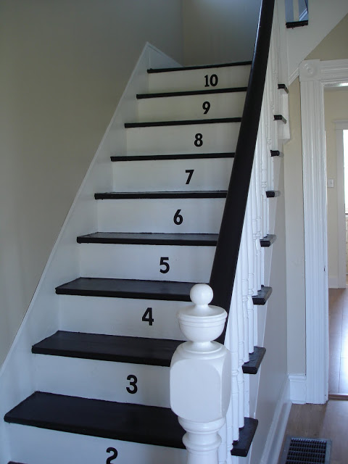
Create an action plan
Notes:
The next step in the strategic planning process is to create an Action Plan.
The action plan describes how strategies will be implemented and includes activities and services to be performed, associated costs, designation of responsibilities, priority order, and time frame involved for the organization to reach its strategic goals.

Slide 52

Concise action statements describing specific efforts we must do well, or improve, in order to achieve the mission.
MUST BE QUANTIFIABLE
Notes:
Objectives are specific, measurable results to be achieved.
Objectives and their timelines are guidelines, not rules set in stone (remember Eisenhower’s statement?).
We describe objectives this way - Concise action statements describing specific efforts we must do well, or improve, in order to achieve the mission and goals.
Objectives must be quantifiable and ideally include timeframes

Slide 53

    Specific
    Measurable
    Achievable
    Relevant
    Timely
Notes:
When developing goals and objectives – want to think of the acronym “S.M.A.R.T.”
While not every one needs to meet every one of these – it is a helpful guide
They should be – specific. They should clearly identify what must be done
They should be measurable – quantifiable – able to be track whether or not it is achieved
Which leads us to achievable – there needs to intuitively be a clear path outlined to get to a defined target or standard
And it should be relevant – there must be a purpose – to achieve a goal or comply with a law – it must matter
And then timely – the key question here is – can (must) it be accomplished within the next 12-18 months (or whatever the established time frame is)

Slide 54

Incorporate performance measures
“Meaningful quantitative evidence used to monitor and track progress towards achievement of desired results.”
Notes:
The next step is to incorporate Performance Measures.
Performance measures provide an important link between the goals, strategies, actions and objectives stated in the strategic plan and the programs and activities funded in the budget.
Performance measures provide information on whether goals and objectives are being met.
We’ll talk more about this in the next section.

Slide 55
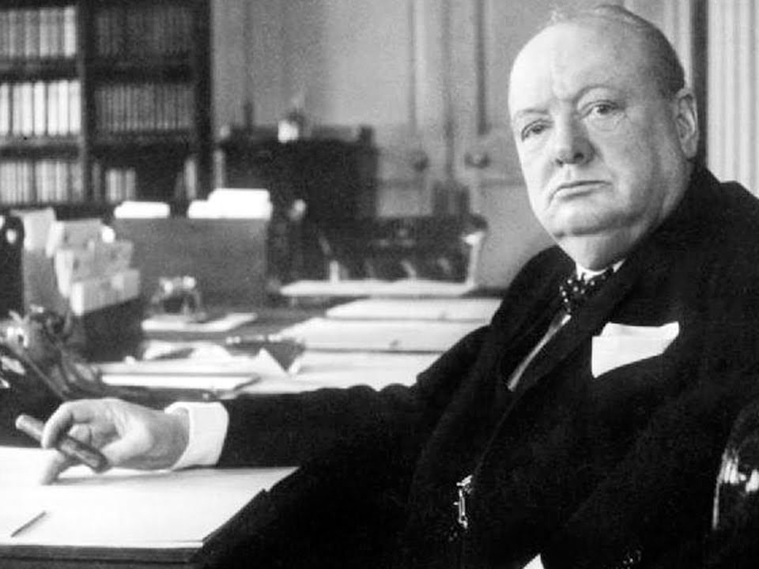
“However beautiful the strategy, you should occasionally look at the results.”
Winston Churchill
Implement, monitor progress and reassess the plan
Notes:
After approval, implement the plan, monitor progress and reassess the plan.
Progress toward planned goals should be monitored at regular intervals. Organizations should develop a systematic review process to evaluate the extent to which strategic goals have been met.
Also, periodically, reassess the strategic plan. Is it working have you seen results?
Many external factors, such as the national or regional economy, demographic changes, statutory changes, legislation, mandates, and climate/environmental changes, may affect the environment and thus achievement of stated goals.
New information about stakeholder needs or results may also require changes to the plan.
Performance measure results need to be reviewed more frequently than the strategic plan.

Slide 56

Align unit strategic plans with the organization-wide assumptions and strategies
Notes:
Any unit, department, division strategic plans should be aligned with the organization-wide assumptions and strategies – not developed in a vacuum,
Alignment should cascade down through the organization – but as part of the environmental scanning process – input should be sought from the organizational units because they are much closer to the action and the trends.
Same principles can be used to develop individual employee goals and objectives, and make sure they align all the way up the organization.

Slide 57
Mission
What is our purpose? Why do we exist?
Goals
What are our main focus areas for the long- and short-term?
Values
What principles govern our actions and the way we do business?
Objectives
What efforts are needed to get results?
Initiatives
What specific activities must be done to ensure we meet the objectives?
Measures
How will we know if we are achieving results?
Notes:
While this is an overall structure – you can modify it to accommodate the needs of your organization –
For example, in Scottsdale, since we have a large organization – with hundreds of different lines of service
We worked to distill down to basics – we call it our strategic planning framework - that everyone in the organization can use
For those departments that are already doing strategic planning – easy to fit in
Each level answers a different question – from mission – which describes at the highest level what we exist to do
To measures which track how well we are achieving what we set out to do.
We used values at the strategies level – to emphasize the Employee Values – which are also strategies we use to accomplish our goals. Some organizations would want to add “vision” about the “mission” level
But this simplified strategic planning framework was designed to be used in any organization.
We’ve also included a one-page overview of this in your packet.

Slide 58






Strategic Goals
General Plan Elements
Value Scottsdale’s Unique Lifestyle and Character | Character and Design
 | Land Use
Economic Vitality | Economic Vitality
Enhance Neighborhoods | Community Involvement
 | Housing
 | Neighborhoods
Preserve Meaningful Open Space | Open Space and Recreation
 | Preservation and Environment Planning
Seek Sustainability | Cost of Development
 | Growth Areas
 | Public Services and Facilities
Advance Transportation | Community Mobility
Notes:
As another resource – here is a breakdown of the six strategic goals, and the 13 elements which cover 93 goals and policies to guide the city in the 2001 voter-approved general plan.
The six strategic goals are the major long-term efforts of the city.
I’ve also included a two-page sheet that shows this in more detail.

Slide 59

Simply better service for a world-class community
Partner with residents and businesses to revitalize the McDowell Road corridor
Provide strategic support of tourism and visitor events
Create and adopt a comprehensive economic development strategy
Develop a transportation strategy that anticipates future needs
Prepare and adopt fiscally sustainable operating and capital budgets
Reinvest in a high performance organization and work culture
Notes:
In addition to the long-term efforts – the city also has mission statement and short-term goals and priorities.
The mission statement – “Simply better service for a world-class community” was approved by the City Council in December.
In addition the city council’s key priorities are listed here. They cover key items such as revitalizing the McDowell Road corridor, to reinvesting in a high-performance organization and work culture.
Finally – these are included in the current organization strategic plan – also included in your packet.
So – how does this all fit in? We consider the City Council priorities – short-term goals to be achieved over 12-18 months time frame, and the six strategic goals from the General plan – long-term goals – to be advanced over a 15-20 year time frame.
This is all referenced on that one-page sheet.

Slide 60

A. Partner with residents and businesses to revitalize the McDowell Road corridor
1. Define the McDowell Road Corridor boundaries and get direction on the appropriate tools to consider in revitalizing the area
2. Listen to key stakeholders to understand current market conditions and ensure marketing efforts are focused on recruiting desired businesses to the area
3. Establish a new “brand” or identity for the McDowell Road corridor
4. Improve linkages to nearby amenities and adjacent communities
5. Improve transit service along the McDowell Road corridor
6. Work with area residents to strengthen neighborhoods in and around the revitalization area
Notes:
This shows you the key objectives for one of the prioritizes to revitalize the McDowell Road corridor.

Slide 61

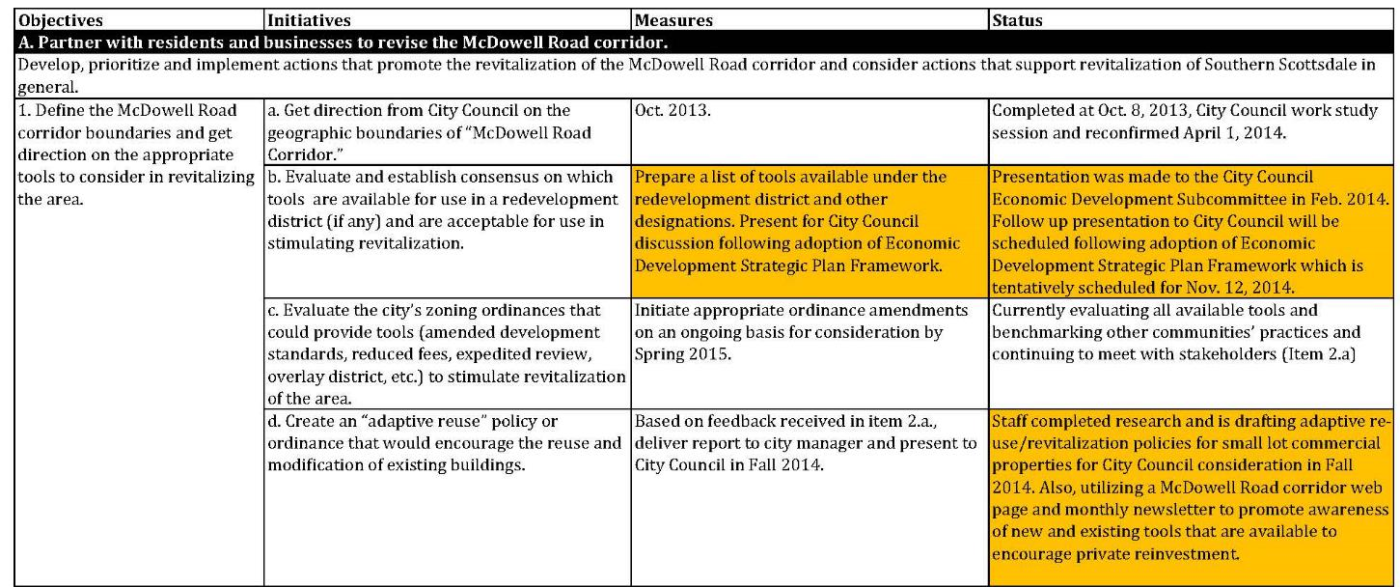
Notes:
And this is the action plan. You can see that there are several measurable initiatives for a key objective. We’ve also provided some status updates on each item. We do this each quarter.

Slide 62

Review or create a strategic plan for her area.
Make sure there’s a mission statement – or create one
Have a few key goals her department is working to accomplish
Work with her team to develop a strategy/logic model to understand how their work helps achieve the mission.
What should Abigail do?
Notes:
What should Abigail do?
Review or create a strategic plan for her area.
Make sure there’s a mission statement – or create one
Have a few key goals her department is working to accomplish
Work with her team to develop a strategy/logic model to understand how their work helps achieve the mission.

Slide 63
Gather data for the SWOT analysis.
Review the strategic plan for the department and see if there’s alignment between the measures and the goals.
What should Daniel do?
Notes:
What should Daniel do?
Gather data for the SWOT analysis.
Review the strategic plan for the department and see if there’s alignment between the measures and the goals.

Slide 64
Participate in planning efforts
Review plans to provide feedback on feasibility
Make sure her work is measurably accomplishing the mission
Suggest changes as needed
What should Emily do?
Notes:
What should Emily do?
Participate in efforts
Review existing plans
Make sure her work is measurably accomplishing the mission
Suggest changes as needed

Slide 65
Measuring
Results
What must you do to achieve your desired results?
Notes:
Now we’re going to focus on performance measures to track the success of our chosen strategies.

Slide 66
    Performance measures are meaningful quantitative evidence used to monitor and track progress towards achievement of desired results
    An indicator describes the environment in which you operate, including external factors that impact services
    Measures are controllable, indicators are not (usually)
Notes:
At this point, I’ll walk through definitions and examples of each type of measures
First, let’s distinguish between indicators and measures
An indicator describes the environment in which you operate, including external factors that impact services
Also called descriptors – indicators include such information as population, square miles and crime rate
Indicators may be influenceable, such as population or crime rates, but are not controllable (usually)
On the other hand, performance measures are controllable – because they measure how well you performed
In addition to measures and indicators – you also have certain conditions that you operate in – these include procedural requirements
Such as environmental laws and safety regulations, but also include such things that you have to respond to, including total calls for service, citizen complaints, etc.

Slide 67
  Types of performance measures
Input
Amount of resources used (or available) to provide services
Output
Amount of work produced or services delivered
Outcome
The desired end result that demonstrates the impact of the services delivered
Indicators
Describe the environment in which the service is provided
Efficiency
Amount of work done per amount of resources used
Effectiveness
Amount of achieved results, or the level of quality relative to the amount of work done
Productivity
Amount of quality work done per amount of resources used
Conditions
External requirements or demands that impact service delivery
Cost-Effectiveness
Amount of outcome achieved per amount of resources used
Notes:
This slide – shows the relationship of the different types of measures to each other (We have also provided a more detailed two-page overview of each measure with the examples)
Inputs lead to outputs that lead to outcomes
Efficiency measures the relationship between outputs and inputs
Effectiveness the relationship between outcomes and outputs
Moving on - Productivity is the relationship between effectiveness and efficiency
Cost-effectiveness is the relationship between outcomes and inputs
In addition, additional information is helpful as part of the performance measurement process
Indicators – which describe the environment in which the service is provided and Conditions – which are external requirements (laws or regulations) or demands (customer complaints or calls for service) that impact service delivery
Main point – if you identify and collect information on inputs, outputs, and quantify your qualitative outcomes – you can measure most anything

Slide 68

Input
  Amount of resources used (or available)
  to provide services
Examples:
Employees or full-time equivalents (FTEs) hours/2,080
Expenditures for library materials
Number of sworn firefighters
Hours paid to sworn police personnel
Physical resources used– electricity, water, gas, steel, cement, asphalt
What’s an input in your area?
Notes:
The first type – inputs – are the amount of resources used (or available) to produce products or provide services
They contribute to the production and delivery of an output, such as expenditures, labor units or physical resources
For our purposes, the amounts that were actually used (not the amounts budgeted) are the relevant numbers
Input measures don’t really tell you anything about performance, but are necessary to create other measures
Looking at your handout – take a moment to jot down some input measures for your area?

Slide 69

Output
  Amount of work produced
  or services delivered
Examples:
Tons of residential refuse collected
Number of lane miles swept
Number of applications processed
Number of sets of city council minutes prepared
Number of arrests
Number of trees planted
What’s an output for your area?
Notes:
The next type – outputs – are the amount of work produced or the amount of services delivered
Outputs are the amount of work done by the organization or contractors – the completed products of internal activity
They are also known as workload measures and can be compared with prior years to see if volume is up or down
They can be divided by indicators such as population to compare relative levels with other organizations
Outputs reveal the quantity of work done, but says nothing about the quality of the work or efficiently it was done
Looking at your handout – take a moment to jot down some output measures for your area?

Slide 70

Outcome
  The desired end result that demonstrates the impact of the services delivered
Examples:
  City facilities are clean, well-maintained and open
  Streets and roads are well-maintained and clean
  Travel/transit times are reasonable & predictable
  Identify outcomes clearly so you can identify the measureable factors that will get you the results you desire
  What’s an outcome for your area?
Notes:
Outcomes are important to measure because they are the desired end result from the services we deliver to customers
Typically qualitative, they are quantified through effectiveness measures, which compares them to a target or standard
Important to understand how inputs and outputs lead to outcomes. What measurable factors influence this outcome?
Evidence about linkages can help identify which inputs and outputs are most important to measure to gauge efficiency, effectiveness, productivity and cost-effectiveness

Slide 71

Efficiency
  Amount of work done
  per amount of resources used
      Examples:
        Number of transactions per FTE
        Cost per work order completed
        Expenditures per case closed
        Road rehab expenditures per lane mile
        What’s one way to measure efficiency in your area?
Notes:
Efficiency measures the relationship between the amount of work done and the amount of resources used
So, efficiency is the ratio between outputs delivered and inputs used to produce the output
A key word for efficiency measures is “per” – expenditures per lane mile; transactions per FTE
Efficiency measures tell you the quantity done relative to the inputs used, they do not tell you the quality of work done

Slide 72

Effectiveness
  Amount of achieved results, or the level of quality relative to amount of work done
  Examples:
Citizen, employee and customer satisfaction, quality and timeliness ratings from surveys
Pavement condition index (PCI)
  % of improperly repaired meters
% of cardiac arrest patients delivered with a pulse
Fire confined to room of origin
        Thinking about your key outcomes, what’s one way to measure effectiveness in your area?
Notes:
Effectiveness measures the amount of achieved results or the level of quality relative to the amount of work done
Called outcome measures because they measure the extent to which outputs achieve desired customer-focus results
Effectiveness measures include customer, citizen & employee ratings; & how you performed to a target or standard
They tell you how effectively you are providing the service, but don’t tell you how efficiently it is being done

Slide 73

Productivity
  Amount of quality work done
  per amount of resources used
      Calculated by dividing an efficiency (or input) measure by an effectiveness measure
      Examples:
  Cost per properly repaired meter
  Cost per vacancy filled successfully
  How might you measure the amount of quality work per amount of resources used in your area?
Notes:
Productivity measures are an efficiency measure that measures amount of quality work done per amount of inputs used
Can help you understand how much resources or time you spend doing work that leads to your desired outcome
Difficult to do, but productivity measures encourage both efficiency and effectiveness.
For example, what’s more important – how much it costs to fill a vacancy?
or how much it costs to successfully fill the vacancy – meaning you find someone that is still performing at or above expectations six months (or a year) after hire.
Why not try and measure that?

Slide 74

Cost-Effectiveness
  Amount of outcome achieved
  per amount of resources used
  Examples:
  Per customer cost to provide after-school programs
  Cost to provide 24-hour turnaround service on all building inspections
  Per customer cost to provide passport services
  Per customer cost for twice-weekly refuse and recycling collection
  Per customer cost to provide neighborhood trolley services
  How might you measure cost-effectiveness in your area?
Notes:
Another way to measure effectiveness is to measure “cost-effectiveness” of the service or how economically it is done
This is the amount of outcomes achieved, per amount of resources used
This is different than “efficiency” measures which are the ratio of outputs created to inputs used
You can also measure the cost-effectiveness of different levels of service – how much for a 24-hour turnaround 12? 36?

Slide 75
  Types of performance measures
Input
Amount of resources used (or available) to provide services
Output
Amount of work produced or services delivered
Outcome
The desired end result that demonstrates the impact of the services delivered
Indicators
Describe the environment in which the service is provided
Efficiency
Amount of work done per amount of resources used
Effectiveness
Amount of achieved results, or the level of quality relative to the amount of work done
Productivity
Amount of quality work done per amount of resources used
Conditions
External requirements or demands that impact service delivery
Cost-Effectiveness
Amount of outcome achieved per amount of resources used
Notes:
This slide – shows the relationship of the different types of measures to each other (We have also provided a more detailed two-page overview of each measure with the examples)
Inputs lead to outputs that lead to outcomes
Efficiency measures the relationship between outputs and inputs
Effectiveness the relationship between outcomes and outputs
Moving on - Productivity is the relationship between effectiveness and efficiency
Cost-effectiveness is the relationship between outcomes and inputs
In addition, additional information is helpful as part of the performance measurement process
Indicators – which describe the environment in which the service is provided and Conditions – which are external requirements (laws or regulations) or demands (customer complaints or calls for service) that impact service delivery
Main point – if you identify and collect information on inputs, outputs, and quantify your qualitative outcomes – you can measure most anything

Slide 76
  Solid Waste Example
Input
Equipment Operators
Output
Tons collected per month
Outcome
Refuse is collected in a reliable and clean manner
Indicators
Number of households
Efficiency
Tons collected per month per operator
Effectiveness
Tons collected per month without complaints of missed or messy collection
Productivity
Tons of complaint-free collection per operator
Conditions
State law requiring twice per week pick-up
Cost-Effectiveness
Cost to provide residential refuse collection services per operator
Notes:
Here’s an example from the trash and recycling collection area.

Slide 77
  Questions performance measures can help answer
Input
How much resources (staff/$$$, etc.) did you use?
Output
How much work was accomplished?
Outcome
What are the desired results (short-term or long-term)?
Indicators
How large is your service area? What population and demographics do you serve?
Efficiency
How much work was accomplished with available resources?
Effectiveness
How well did you achieve the desired results?
Productivity
How much time/effort was expended on quality work?
Conditions
What legal or regulatory requirements impact how you provide service?
Cost-Effectiveness
How much value was provided per dollar spent?
Notes:
It’s important to understand the questions that different measures answer.
Inputs tell us how much resources we used
Outputs tell us how much work we accomplished
Outcomes tell us what we are trying to accomplish – either over the short or long term
Efficiency measures tell us how much work we accomplished with available resources
Effectiveness measures tell us how well we met our intended objectives
And so on and so forth…

Slide 78

Are you staying with me? Any questions?
Notes:
I realize at this point – it can be like drinking from a fire hose – are you staying with me? Any questions?

Slide 79
Group Exercise
Pick one key service that you provide
Fill out the performance measures chart
Share your chart with others at your table
One person should be willing to share with the class
Notes:
Now it’s your turn – thinking about your one key service –
Complete the rest of the chart –
Share with others at your table –
And then we’ll take volunteers .

Slide 80
  Now it’s your turn…
Input
Output
Outcome
Indicators
Efficiency
Effectiveness
Productivity
Conditions
Cost-Effectiveness

Slide 81

1
2
3
5
6
4
7
8
10
11
9
12
Notes:
Now the challenge at this point is not what you can measure, but what you should measure.
Let’s be clear – each of you are the experts in the area you are responsible for – you know whether you’re successful or not,
You know all the details – you know how everything fits together – better than anyone else.
The challenge is getting others – your customers, managers and employees – to understand how well you are doing.
But they’ll never know as much as you do – so you have to “Paint a Picture.”
The best image I can think of is the “reveal a picture game.” You reveal a little bit of the picture at a time and try to guess the picture.
Sometimes you can uncover a lot of boxes – and still have no idea what the picture is! Other times you can select just 1,2 or 3 boxes – and know what it is.
Selecting performance measures is similar to this.

Slide 82

82
Select a palette of performance measures
Notes:
So that’s why my advice is to select a palette of performance measures
Choose efficiency and effectiveness measures to demonstrate how well you are achieving your desired results,
But include some key output measures, and perhaps some indicators
To give a sense of the volume of work you are doing.

Slide 83
83
Your palette should be:
relevant understandable complete
Notes:
It’s tempting to measure everything – and report everything
But like in many areas – quality is more important than quantity
Make sure your selected measures are
Relevant – they matter
Understandable – they’re clear
Complete – core services are measured.

Slide 84
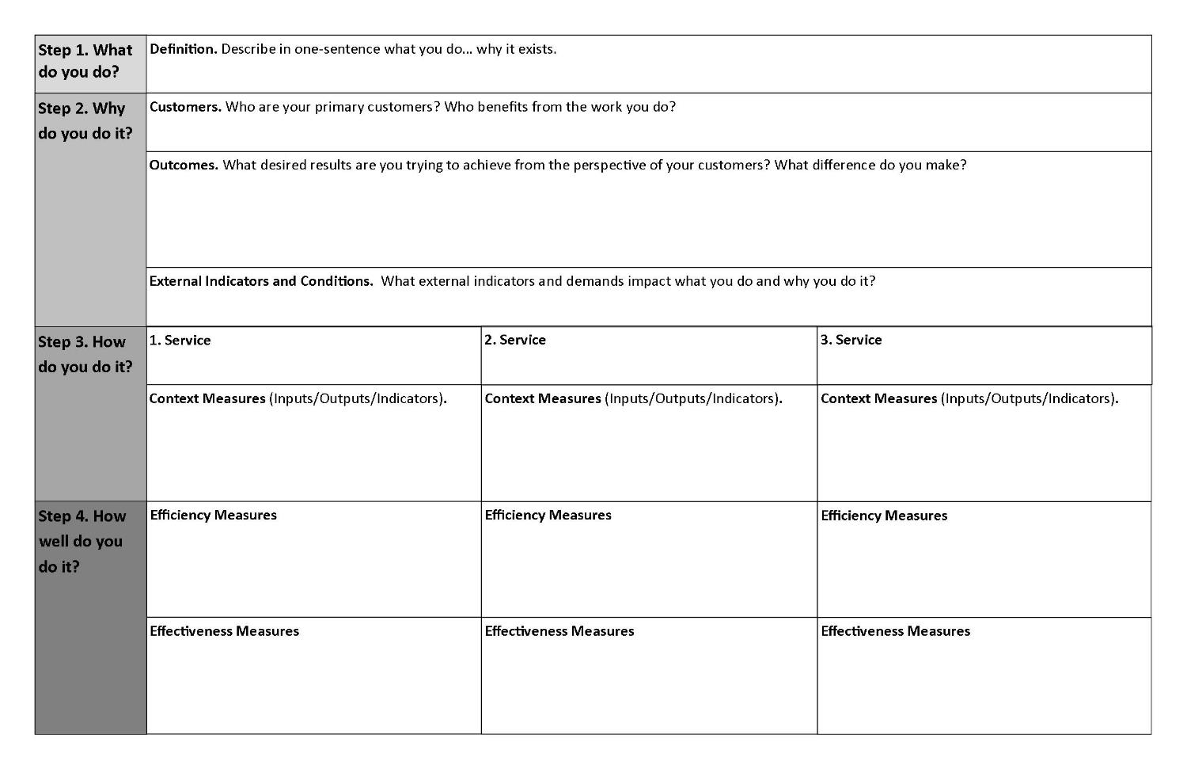
Notes:
I have a one-day session that I can do with a department or work area to flesh this out.
This is a mini-strategic planning process to help departments through the process of making sure their measures are adequately measuring the key services that help them achieve customer-focused outcomes in support of their mission.
We use this “placemat” as a resource for walking through the process.
We do the process in four steps:
What do you do? – Your mission
Why do you do it? – Your customers and what they value
How do you do it? – The services you provide
How well do you do it - Your key measures

Slide 85

  Why measure?
If You Don't Measure Results,
You Can't Tell Success from Failure
If You Can’t See Success,
You Can’t Reward It
If You Can’t Reward Success,
You’re Probably Rewarding Failure
If You Can't See Success,
You Can't Learn From It
If You Can't Recognize Failure,
You Can't Correct It
If You Can Demonstrate Results,
You Can Win Public Support
    David Osborne and Ted Gaebler. 1992. Reinventing Government: How the Entrepreneurial Spirit Is Transforming the Public Sector.
Notes:
So why measure? Authors of Reinventing Government summed it well in these six statements
[read statements]
it’s clear -- when government lacks objective information; decisions can hinge on political (or personal) opinions
But – with measures – people begin to ask right questions; redefine issues; diagnose problems; focus on outcomes

Slide 86
Lead her team in an effort to identify possible performance measures
Build a palette of measures that are relevant, understandable and complete
What should Abigail do?
Notes:
What should Abigail do?
Lead her team in an effort to identify possible performance measures
Build a palette of measures that are relevant, understandable and complete

Slide 87
Evaluate the selected measures to ensure they provide a relevant understandable and complete picture of performance in the department
What should Daniel do?
Notes:
What should Daniel do?
Evaluate the selected measures to ensure they provide a relevant understandable and complete picture of performance in the department

Slide 88
Provide feedback on whether the measures accurately measure what they are trying to measure
Make sure data is accurate and reported in a timely manner
What should Emily do?
Notes:
What should Emily do?
Provide feedback on whether the measures accurately measure what they are trying to measure
Make sure data is accurate and reported in a timely manner

Slide 89
Evaluating and Reporting
Results
What must you improve to achieve your desired results?
How will you know if you are successful?
Notes:
Next we will look at the review and revise steps together

Slide 90
Why did it happen?
Questions for evaluation:
What happened?
How did it happen?
Was this the most efficient use of resources?
How effective was the effort?
How can we improve on the result?
Notes:
So you have a plan, and you have a good palette of measures – now what?
You want to actually evaluate performance against the plan and look at the data you’ve started measuring.
Here are some key questions for evaluation once you’ve established what happened.

Slide 91

Assign staff to analyze the performance data
Ask questions about the data – does this make sense?
Regularly review reports as part of the management cycle
Notes:
An important step is to make sure that someone is assigned to analyze the data – if you don’t do that, you’re just creating reports that aren’t used for evidence-based decision-making.

Slide 92

Historical Trending
Notes:
So the first type of evaluation you can do is historical trending
Compare to one or more previous reporting periods
Identify unusual jumps or dives in the value of individual measures
This helps show time trends – situations where changes over time indicate particular patterns
When significant program changes occur – you can look at later measurement to determine whether the changes occur as expected.
Let’s walk through some basic examples.

Slide 93
Notes:
What about this chart?
Two conclusions – something happened last year; and maybe all the previous year’s were not accurately reported

Slide 94
Notes:
What about this chart?
Obviously cyclical – could be election-related – or anything that happens (or doesn’t happen) every two years

Slide 95
Notes:
What about this chart?
Downward trend – accelerated downward at a faster rate between 2012 and 2013

Slide 96
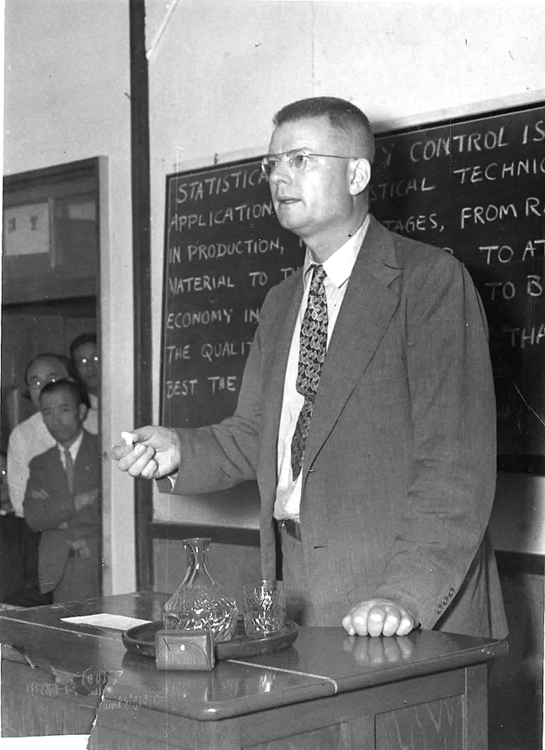
“We must understand variation.”
(avoid management tampering)
Dr. W. Edwards Deming
Notes:
In any data, there are always variations, between people, in output, in service and in product.
Distinguishing the difference between variation, as well as understanding its causes and predicting behavior, is key to management’s ability to properly remove problems or barriers in the system.
However, without knowledge of variation, management might very well (with the very best intention) take action that actually makes things worse.
Dr. Deming called that “management tampering.”
An example? one person makes a mistake – so you pass a law or a regulation to address that. Ever experienced that?
“Why did something go wrong?” “Why are results so poor?” “How can we repeat this success?” The job of management is to not only ask these and other important performance-related questions, but also to find the right answers and take the right course of action.

Slide 97

    Targets express a specific level of performance the organization is aiming to achieve.
Notes:
It’s clear performance is more likely to occur when you’ve identified a standard for comparison
In the game of golf – it’s called “par” – and you measure your progress relative to that standard
Your target may be a “birdie” – better than the standard; or a “bogey” worse, & for others it goes downhill from there
So targets – are a specific level of performance the organization is aiming to achieve

Slide 98
    Standards (also called “benchmarks”) express the minimum acceptable level of performance that is expected and achieved by other, high-performing organizations.
Notes:
In addition to targets –
Standards are the minimum acceptable level of performance expected & achieved by other high-performing organizations

Slide 99
    How else will you know how well you are doing without context?
Notes:
Identifying standards and setting targets are important – how else will you know how well you are doing?

Slide 100
A key question to ask is: “compared to what?”
Notes:
So he first question you should ask when looking at any performance measure is – “compared to what?”
When someone reports their weekend golf score – we ask “what’s par for the course.” That’s a good evaluation question as well.

Slide 101

Target setting
Notes:
So another tool for evaluation is target setting - comparing the latest data to targets that have been set.
Targets are generally thought to be useful because they have motivational value, they hold people accountable, and without targets performance is too ambiguous.
However targets have important drawbacks as well. Targets are largely an arbitrary number. And in some cases can encourage people to “game the numbers,’ if not outright cheat.
Targets should be set carefully – avoid unintended consequences – what negative behaviors they might be incenting. For example, measuring “closed” cases – from the earlier Dilbert slide – which resulted in cases closed prematurely.
In addition, target setting is an art and can be subject to political pressure.
Best set by those closer to the work, rather than from the outside.
For internal management purposes, it’s likely to be helpful in encouraging performance improvement – if the targets are realistic
If there’s considerable uncertainty – consider expressing targets as ranges rather than single values.

Slide 102
Notes:
So – back to our examples
What if we add a standard or target – what now?
We’ve got a lot of work to do to reach the standard, and we’re heading in the wrong direction

Slide 103
Notes:
And what if the standard is here? What now?
One question might be, can we divert resources away from this area – to one that’s below standards (Prior slide)

Slide 104
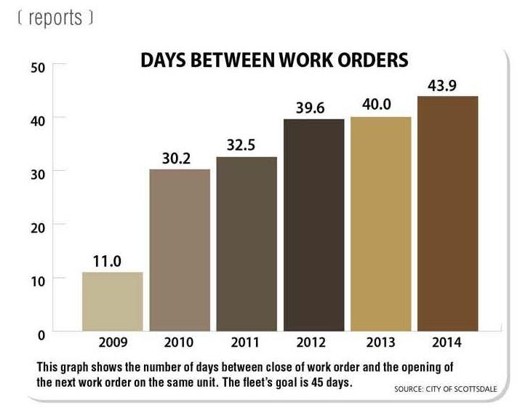
Notes:
Here’s an example from a recent article on Scottsdale’s Fleet Department “Report your way to improved productivity.”
This measures days between fleet work orders – the goal is 45 days.
The department has set that as it’s target and is specifically working to improve performance over time – so looking at the historical performance you can see improvement over time.

Slide 105
Notes:
this table is from our quarterly performance report that we just started this year.
We’re starting to report on a quarterly basis, our progress towards the targets reported in the annual budget.

Slide 106

Benchmarking
Notes:
Next – let’s talk about benchmarking. Comparing one organization’s performance to another.
This is comparing results to other agencies delivering similar services to similar customers

Slide 107

Comparing performance with other organizations
Notes:
But because of the complexity of each of our organizations
It is often hard to make apples-to-apples comparisons
Sometimes because the differences are overwhelming,
or too difficult or too time-consuming to research and explain,
We give up.

Slide 108
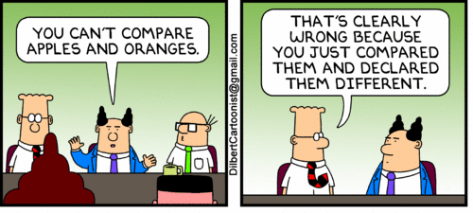

Slide 109

We compare for context
Notes:
But – the truth is – as human beings – we learn by comparing.
Apple, orange, pear, lemon
Boy, girl
Short, Tall
Rich, Poor
Needs Improvement, Outstanding
A, B, C, D, F
Employees or contractors
Department or district
City, County, Town,
Comparisons are helpful because they give us context for decision-making

Slide 110

Notes:
We’ve all been to the grocery store

Slide 111

Notes:
And had to choose between competing options for how we can spend our hard-earned money

Slide 112
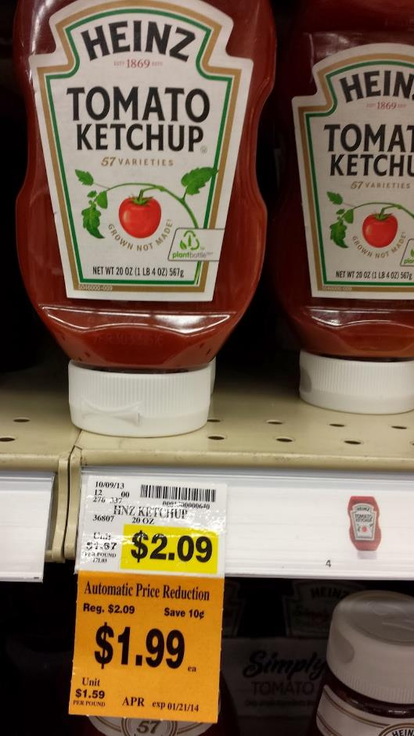
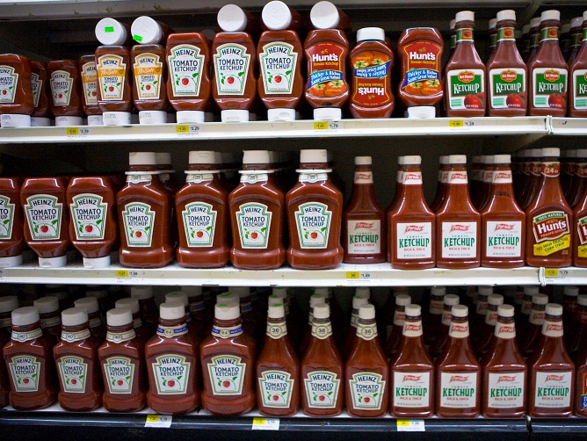
Notes:
I couldn’t survive a grocery trip – without the cost per ounce comparison on the grocery shelf!

Slide 113

We compare for validation
Notes:
And yet, we often ask citizens to have trust and confidence in the work we do…
What they pay and receive for our services without similar information.
We may believe we’re unique and that we’re un-comparable!
But we’re challenged to have good comparative information
so that we can demonstrate our differences and similarities
To others who don’t have the depth of knowledge that we do about our areas of expertise
To validate our claims about our level of performance

Slide 114

We compare to track our progress
Notes:
And to track our progress and growth

Slide 115

We compare for motivation
Notes:
Comparing with others can also be motivational – it helps our performance improve
For example, when we watch a sports event and see something unusual or unique
Within seconds the statisticians are there to help us understand when that has happened before
or not

Slide 116

Notes:
What are they looking at? Their times? Right?
They want to see if they’ve beaten their past performance, and the times of their competitors

Slide 117

Notes:
Sporting events have entertainment value to us
Solely because of the comparisons and competition

Slide 118

We compare to understand
Notes:
Now local governments are not sporting events or swimming competitions
But – hopefully you can see that
As humans we are interested in comparing to better understand us
and the world around us.
So it’s only natural that others compel us to do the same
Our councils, local newspapers, our citizens – are seeking comparative information
to better understand what we do and why we do it.

Slide 119
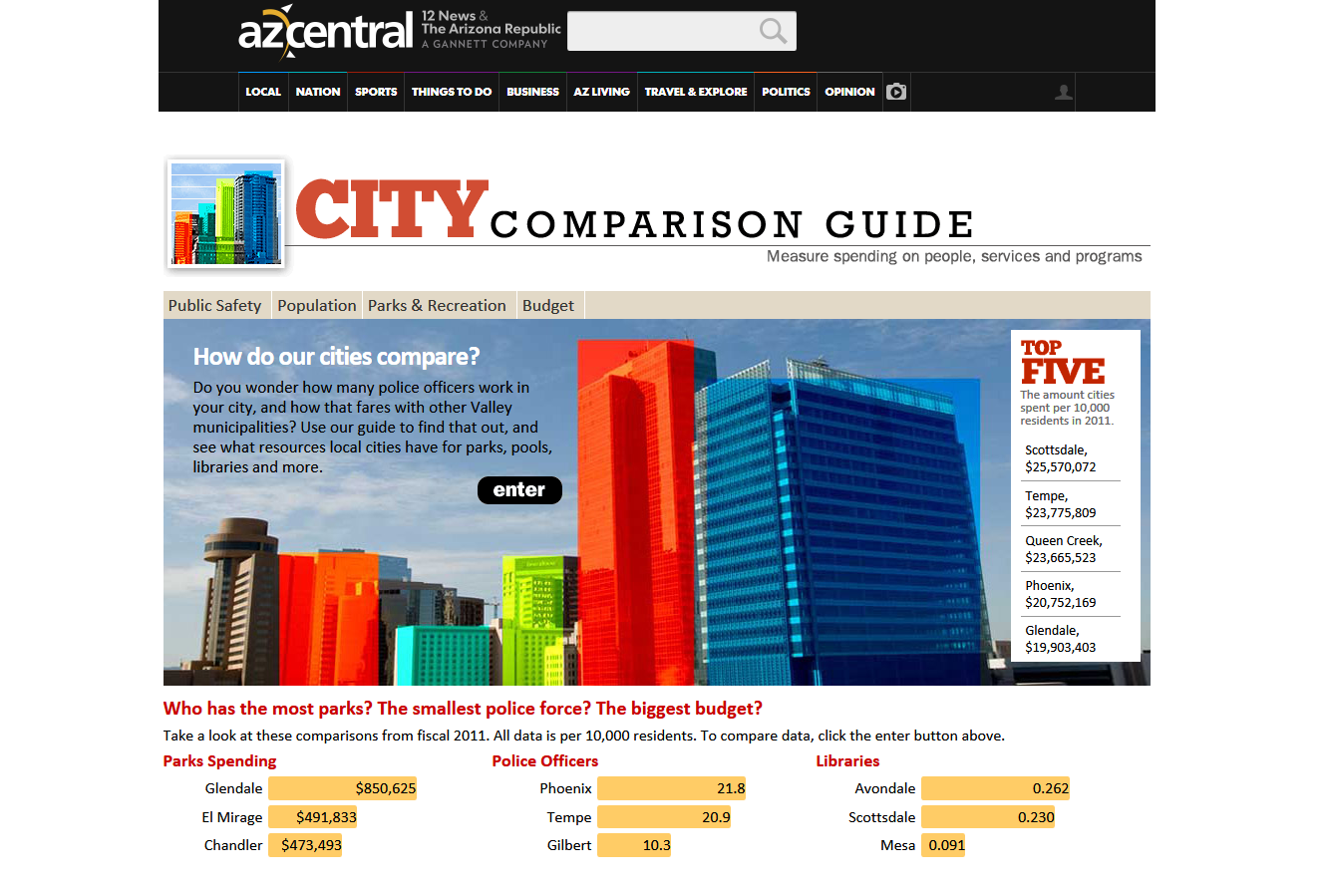























If we don’t compare, others will
Notes:
It’s clear – if we don’t compare… others will… and do
And how you compare, and what you know about whom you’re comparing to
makes all the difference.

Slide 120
What’s in it for us?
“Residents who experienced …
‘operational transparency’ in government services – seeing the work that government is doing – expressed more positive attitudes toward government and greater support for maintaining or expanding the scale of government programs.”
Harvard Business School study, 2013
Notes:
What’s in it for us?
The better job we do explaining – clearly – what we are doing, the better it will be for our cities.

Slide 121
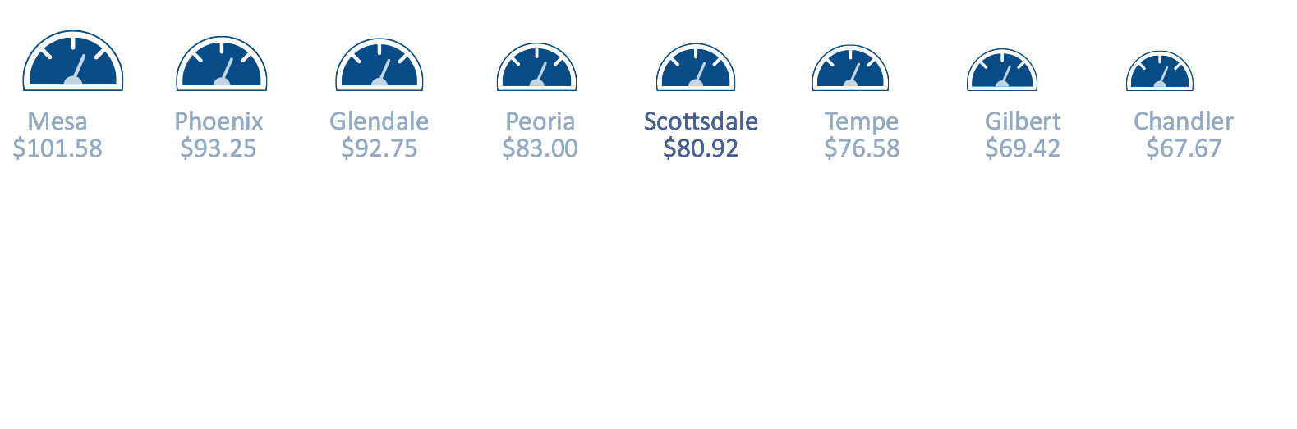

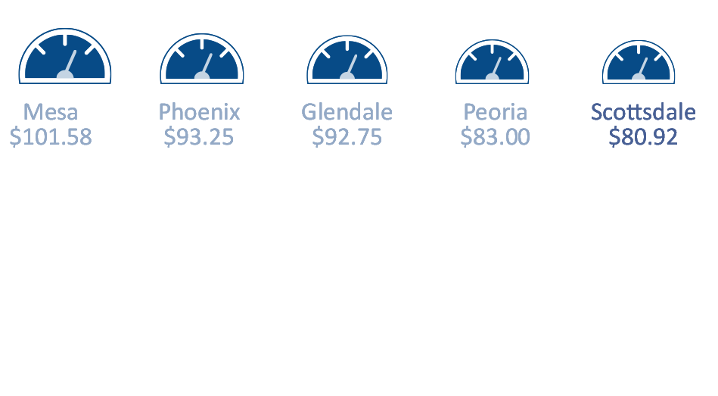

How will you know how you are doing without context?
Notes:
For example, here’s just one indicator that we’ve shared in our annual report.
As you can see – with just our monthly utility bill – you don’t know very much
But if you compare with others – we’re low! Or maybe more in the middle.
With comparisons - more and more of a complete picture is revealed.

Slide 122
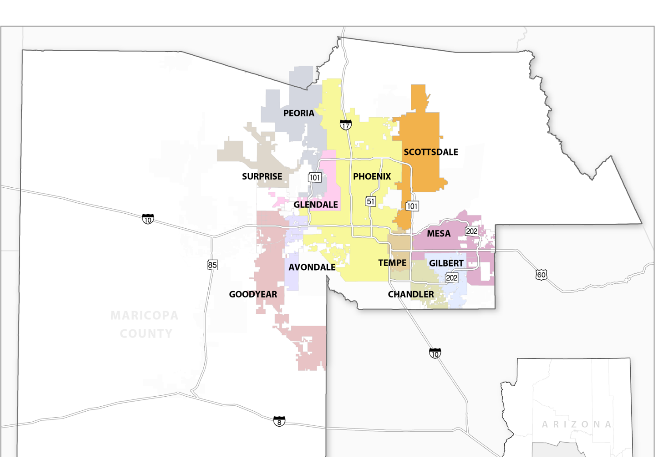











Valley Benchmark Cities
Notes:
In 2010, while Arizona was still in the depths of the great recession
Scottsdale embarked on a journey with other Valley cities to learn through comparisons
We invited Chandler, Gilbert, Glendale, Tempe and Peoria to join us at first
Mesa and Phoenix quickly joined in too
And Goodyear, Avondale and Surprise didn’t want to be left out.
We’ve met most months over the past three years –
to share our data, our best practices, and to learn from each other
It’s not easy – but it’s been worthwhile
And each time we meet - we learn more about each other – and our own cities

Slide 123
“Evidence suggests that improved performance
occurs at a much greater rate when
performance measures are compared.”
Smith and Cheng, 2004
Notes:
So as you can see taking the time to compare is a worthwhile effort
And it’s a great way to learn so that you can improve organizational performance.

Slide 124
Notes:
What conclusions can you draw from this chart? Not much, right – only that there is a change from year to year
Don’t even know if it’s positive or negative; good or bad

Slide 125
Notes:
let’s assume higher is better, and lower is worse
The data from the previous slide is noted as “a”; I’ve added four other comparables; and even calculated the average
What can you conclude from this? [prompt – typical budget liaison/executive director says – “better than average”
What might you do if you knew this was the performance of Scottsdale and four other peer cities?
D similar; C and E better; B – something bad is happening there!
So you can see how comparing information assists greatly with evaluation.

Slide 126
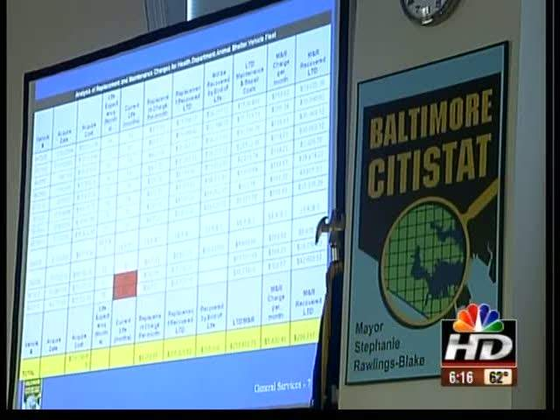
Tips for successful Performance Review Sessions:
Leadership sufficiently interested to support and participate in regular meetings
A process that provides timely and accurate data on program outputs and outcomes
Staff that can assist the leader in examining the data and provide advice on issues to address at the meetings
Performance Review Sessions
Notes:
Another tool is the monthly or quarterly management performance review session.
This gained popularity first in the policing world, but have spread more broadly.
Here are some keys to successful sessions
Leadership must be interested
Data must be regularly available
Staff must assist management in examining the data and providing advice on issues that need addressing.

Slide 127

Data validation
“But you must never forget that every one of these figures comes from the village watchman, who just puts down what he damn well pleases.” Sir Josiah Stamp, 1911
Notes:
Another thing to think about in evaluation is data validation.
An English economist from the early 20th century wrote this:
“The government ministries are very keen on amassing statistics. They collect them, raise them to the nth power, take the cube root, and prepare wonderful diagrams. But you must never forget that every one of these figures comes in the first place from the village watchman, who just puts down what he damn well pleases.”
So – when reviewing data ask - does the number make sense?
Make sure you do not create incentives for departments to falsify results, but rather create incentives for accurate results

Slide 128
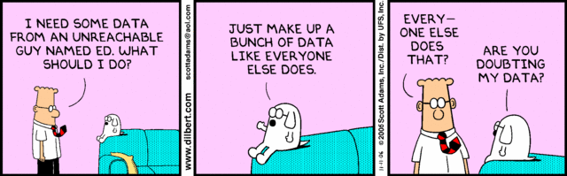
      Don’t be surprised
      when measures
      are revised
Notes:
One thing that happens with performance management and evaluation – is sometimes you find out the numbers you were given are incorrect.
That happens – my advice – don’t be surprised, when measures are revised.

Slide 129
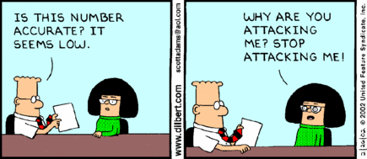
      Don’t take it personally…
Notes:
And when you evaluate and ask tough questions – there will be a reaction.
My advice – don’t take it personally.

Slide 130

Performance Management is
communication.
Notes:
Now let’s focus on communicating and reporting results.
The first thing to remember is performance management is all about communication.

Slide 131

Reports give a glimpse inside the manager’s brain.
Notes:
When you prepare reports – you should always think about how the information will be received and perceived by others.
Reports should give insight into the management perspective but report in a citizen-friendly format

Slide 132
simplicity
Notes:
In other words – we work for simplicity
Alan Siegel and Irene Etzkorn, authors of the book “Simple: Conquering the Crisis of Complexity”, tell us three steps to simplicity

Slide 133
Empathize
Perceive others needs
& expectations
Notes:
Empathize - Perceive others needs & expectations – ie, write for your audience

Slide 134
Empathize
Perceive others needs
& expectations
Distill
Boil down &
customize
to meet needs
Notes:
2. Distill – Boil information down & customize it to meet the needs of your audience

Slide 135
Empathize
Perceive others needs
& expectations
Clarify
Make it easier
to understand
& use
Distill
Boil down &
customize
to meet needs
Notes:
3. Clarify – Make it easier to understand and use

Slide 136
Empathize
Perceive others needs
& expectations
simplicity
Clarify
Make it easier
to understand
& use
Distill
Boil down &
customize
to meet needs
From: “Simple: Conquering the Crisis of Complexity,” Alan Siegel and Irene Etzkorn (2013)
Notes:
Achieving simplicity does not mean “dumbing it down” … in fact it is widely known that making things simple is not easier.
Mark Twain allegedly once said, “I apologize for the length of this letter; I did not have time to write a shorter one.”
We recognize that it’s more work – but if we are truly creating communication for our audience, it is important and necessary.

Slide 137
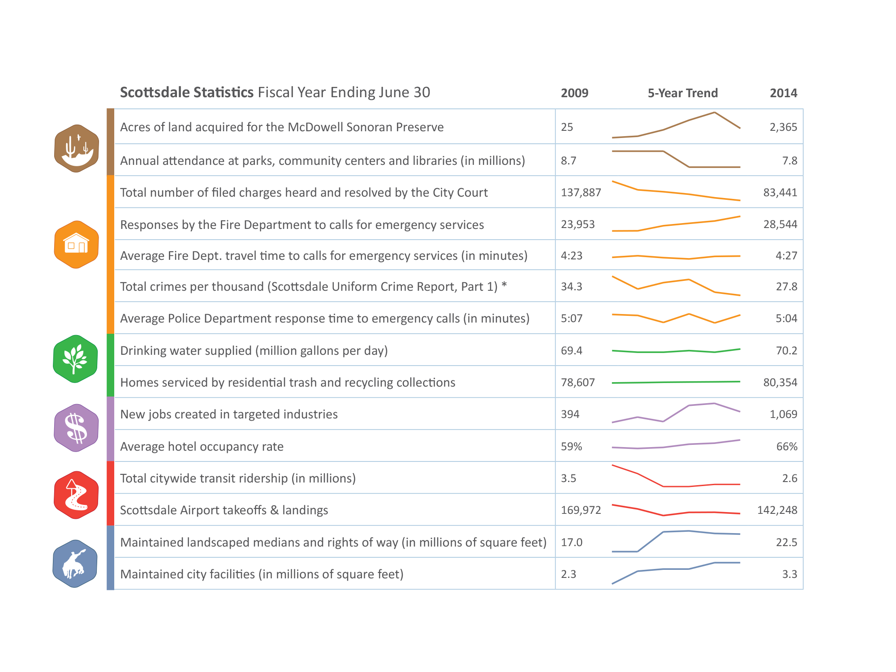
Notes:
Brent
Here’s an example from our citizen-friendly 4-page annual report.
We took basic indicators that we were reporting multiple years of data in our comprehensive annual financial report,
Grouped them by our strategic goals
And showed a 5 year trend by using the sparkline feature now available standard with Microsoft Excel.

Slide 138
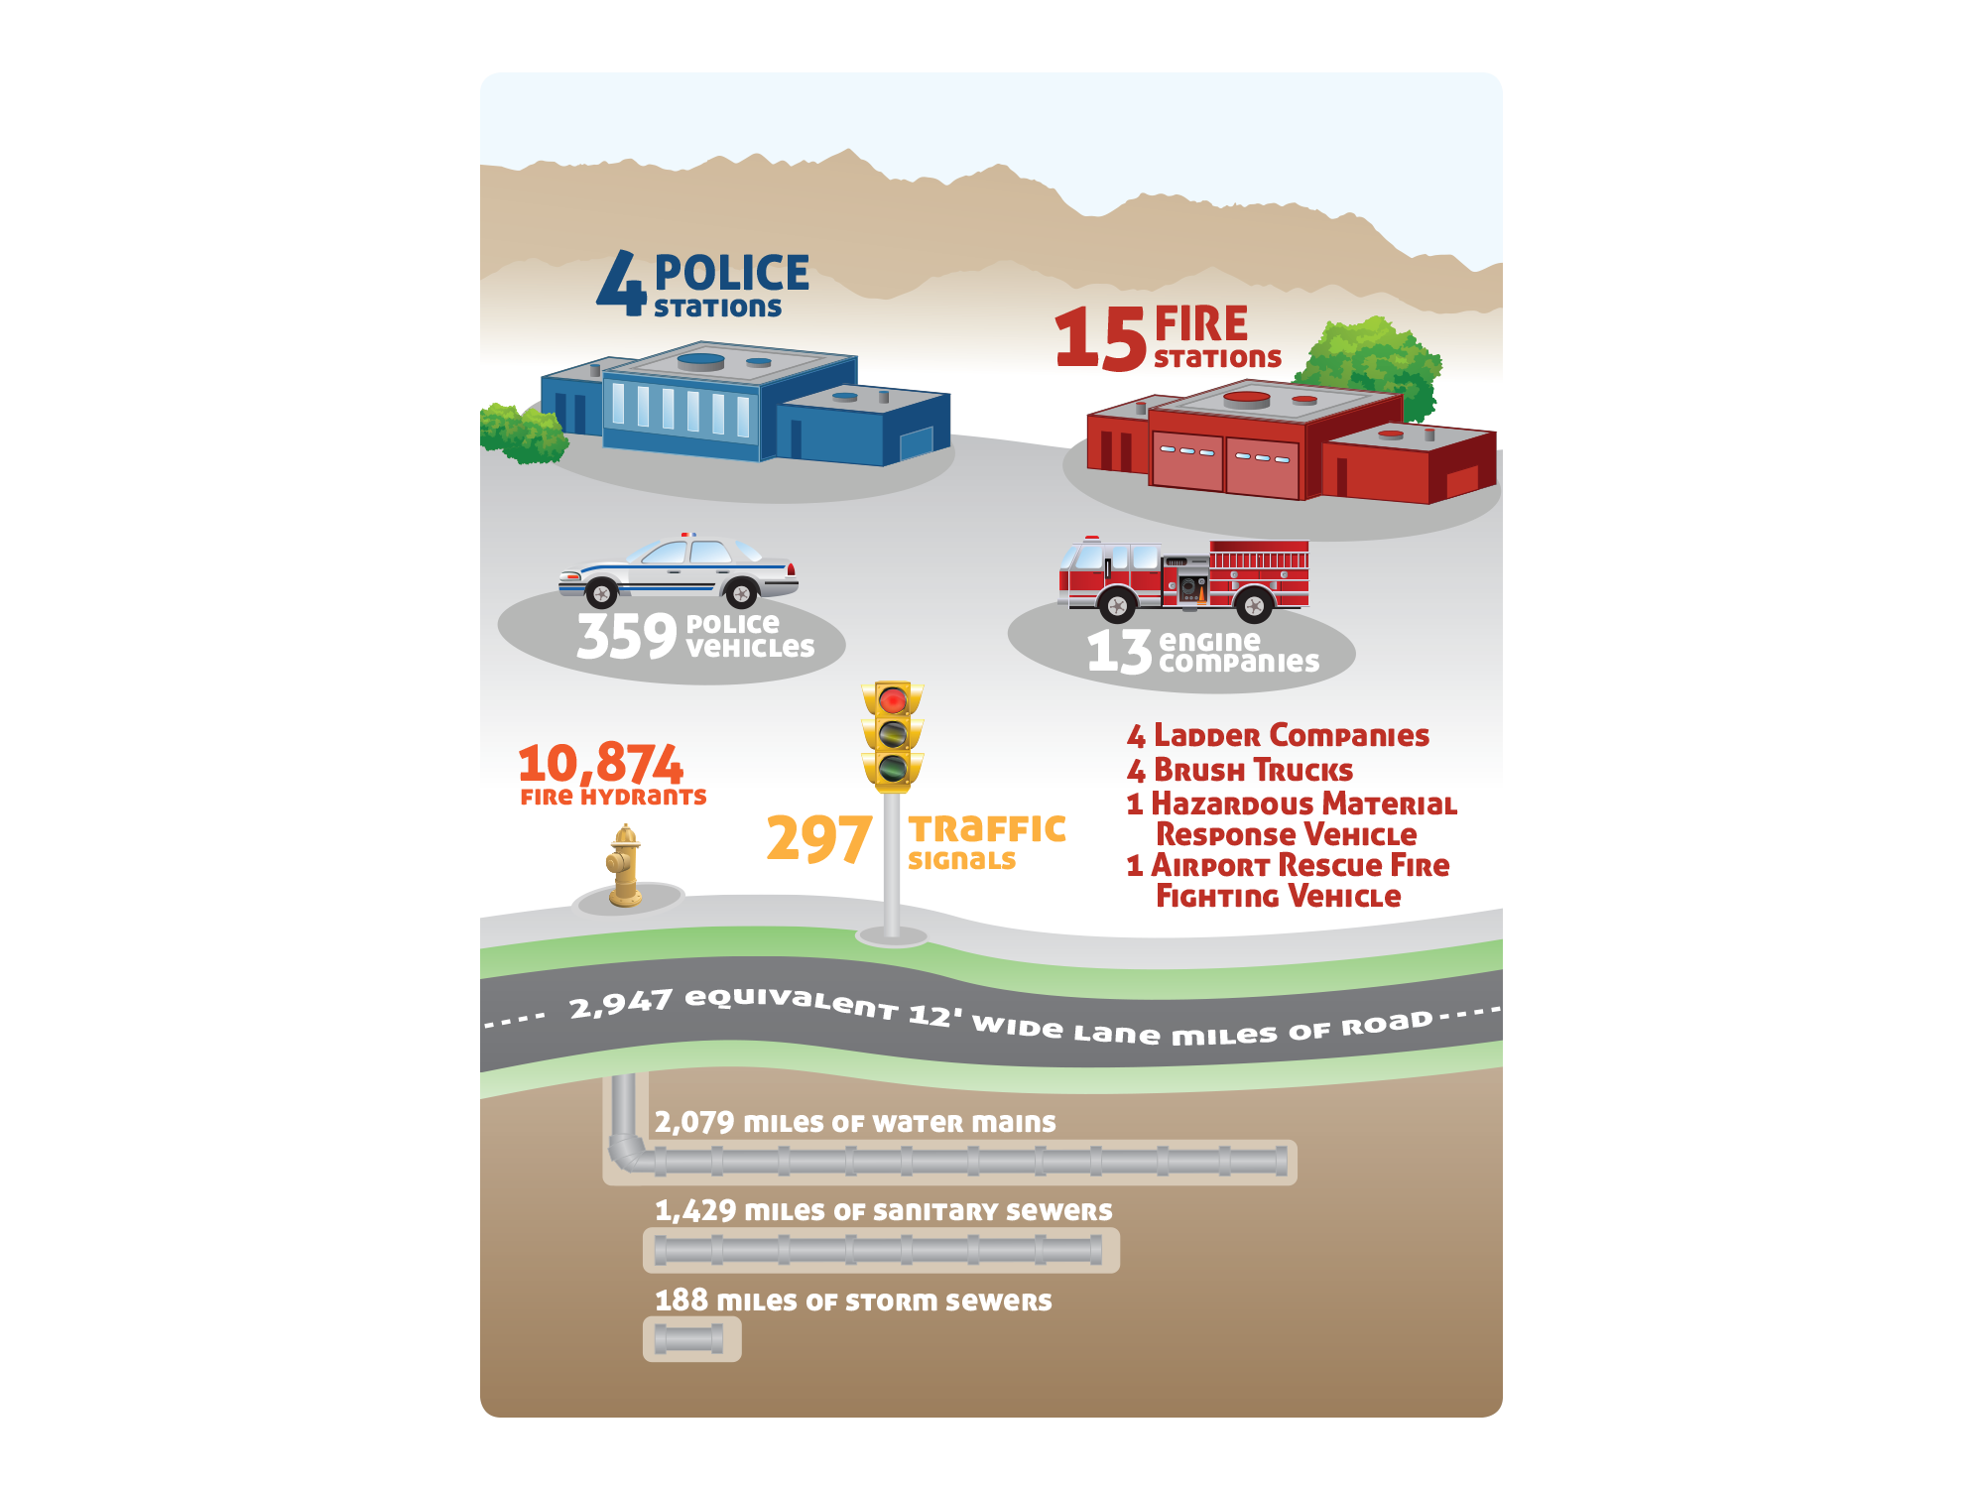
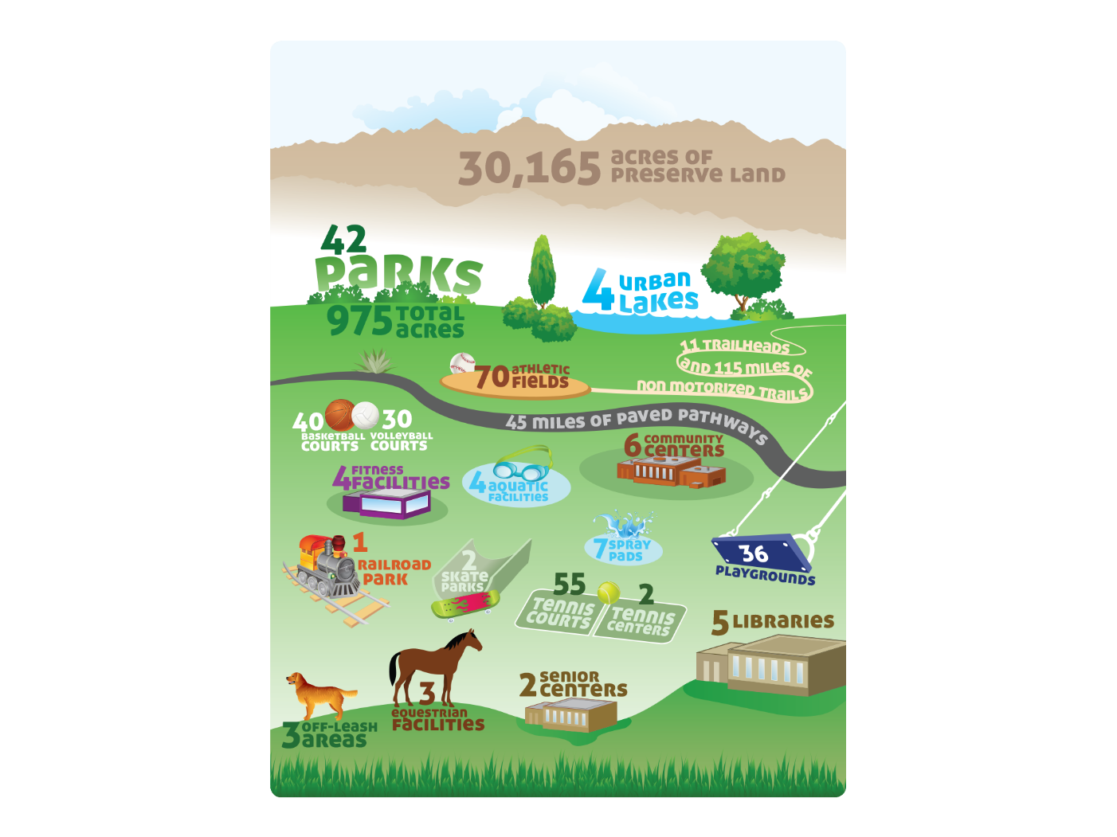
Notes:
Brent
We also took our “capital assets and facilities” section of the CAFR and made it graphically more compelling – same information – just more interesting to look at.

Slide 139
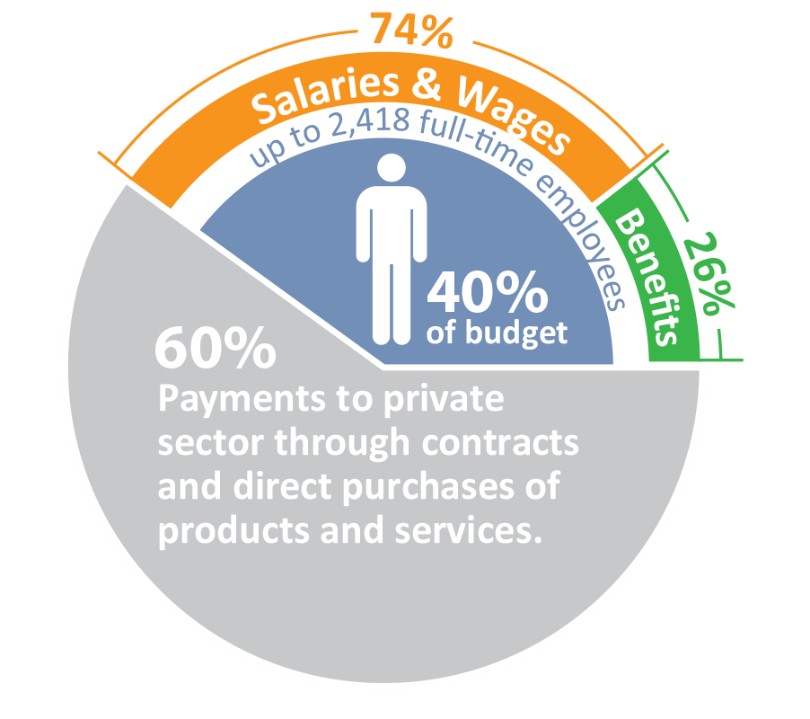
Notes:
Brent
We’ve also used graphics to share more information about some data
For example – here’s how we displayed how much of our operating budget goes to
Government employees – versus to the private sector.

Slide 140
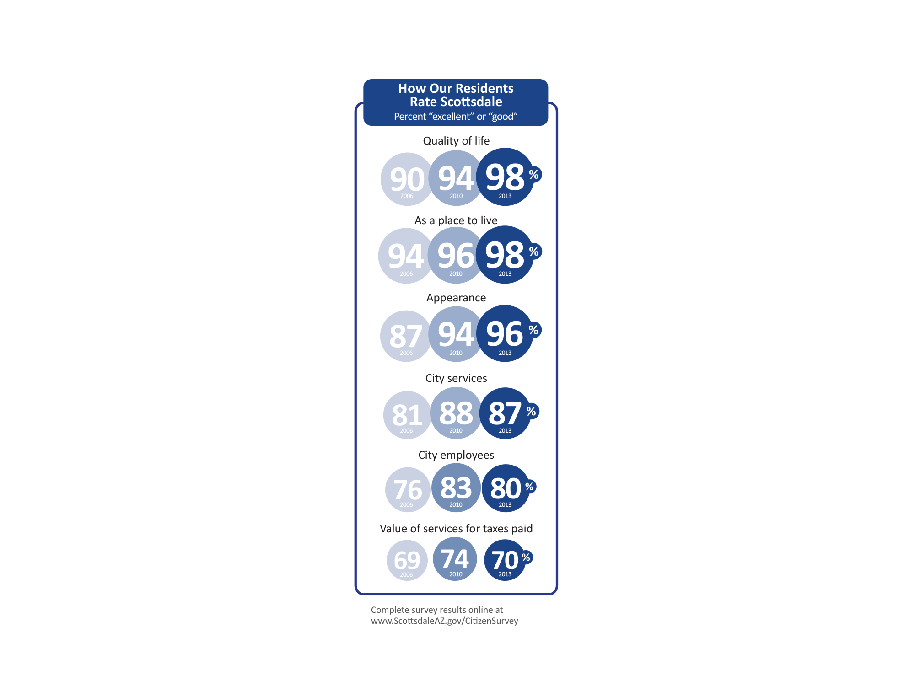
Notes:
Brent
We’ve also tried to share our citizen survey data with greater simplicity.

Slide 141

“effective information visualization (is) premised on:
simplicity
(complex notions simplified to save time for reader);
transparency
(visual honesty and responsibility in sourcing);
creativity
(design that is memorable and understandable);
sociability
(easily shared and improved)”
@Sambrook
http://www.edelman.com/p/6-a-m/visualizing-information/
Notes:
As guiding principles for performance reporting, we found these 4 premises of effective information visualization
[Read principles]
We have really tried to use these as our key guidance as we’ve communicated data

Slide 142
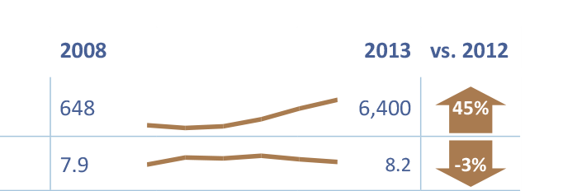
“effective information visualization (is) premised on:
simplicity
(complex notions simplified to save time for reader)
Notes:
For example – rather than putting six columns of numbers – we added a sparkline to visually show a trend – and an arrow to show which direction we’re heading.

Slide 143
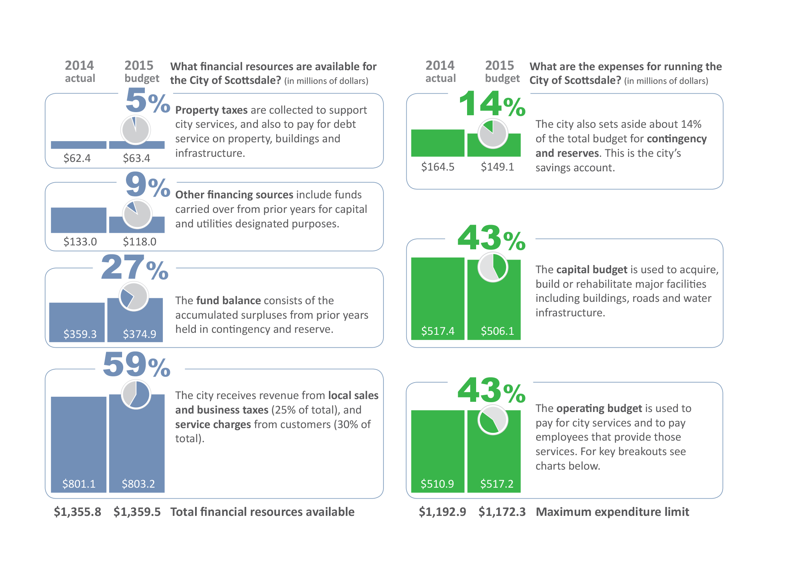
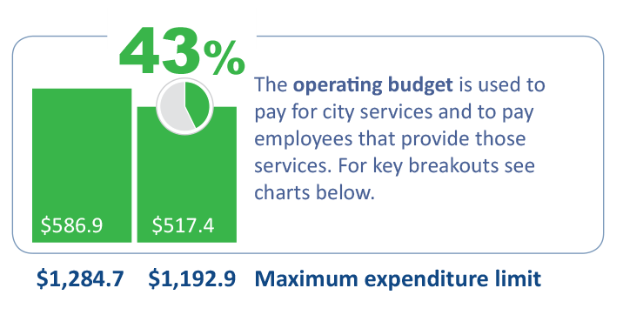
“effective information visualization (is) premised on:
transparency
(visual honesty and responsibility in sourcing)
Notes:
Instead of using a standard pie or bar chart – we’ve taken a couple of techniques to display the financial data with visual honesty – and provide more context and information.

Slide 144



“effective information visualization (is) premised on:
creativity
(design that is memorable and understandable)
Phoenix is almost 7 times larger than Scottsdale!
Notes:
We also try to be creative – put things in perspective – make it easier to remember.

Slide 145
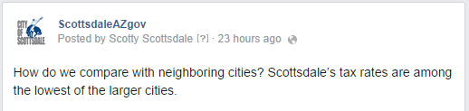
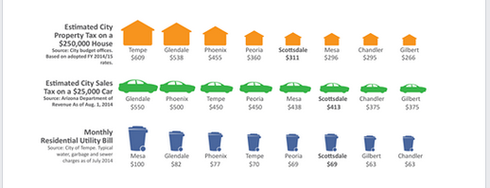
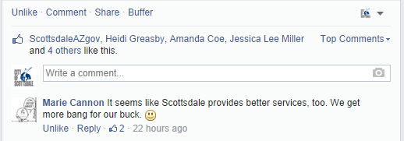
“effective information visualization (is) premised on:
sociability
(easily shared and improved)
Notes:
And while we’re still working on this – we’re thinking about how to make it easily shared.
We call this – giving people “walking around information.”

Slide 146


Edward R. Tufte
The Visual Display of Quantitative Information, Edward R. Tufte, 2001
@EdwardTufte
Notes:
A few more tips – one of the leaders in the display of data is Edward Tufte
He has a number of key concepts that are very influential – let me share two.

Slide 147
Remove Chartjunk
“interior decoration of graphics generates a lot of ink that does not tell the viewer anything new.”
Notes:
Here is the default setting for a bar chart in PowerPoint.
What do you notice?
Tufte calls this “chartjunk” --

Slide 148
Increase Data-Ink
“data graphics should draw the viewer’s attention to the sense and substance of the data, not to something else.”
Notes:
Here’s what is left if you remove the chart junk
Leads us to a second concept – increase data ink
The same is true for writing – remove the stuff that doesn’t matter, and make sure the most ink is dedicated to what does matter.

Slide 149
Accessible Complexity: The Friendly Data Graphic
Characteristics of friendly graphics
words are spelled out
words run from left to right
little messages help explain data
avoid elaborately encoded shadings, crosshatching and colors
labels are placed on the graphic itself; no legend is required
graphic attracts viewer, provokes curiosity
colors, if used, are chosen so that color-deficient and color-blind (5 to 10 percent of viewers) can make sense of the graphic (blue can be distinguished from other colors by most color-deficient people)
Type is clear, precise, modest
Type is upper- and lower-case, with serifs
The Visual Display of Quantitative Information, Edward R. Tufte, 2001, p. 183
Notes:
When using visuals –
Consider these key concepts.
These are all designed to simplify concepts and make it easier for reader comprehension.

Slide 150
Total Full-Time Attrition and Unemployment Rate
13.3%
11.0%
Retirements
10.0%
9.3%
8.4%
4.4%
Unemployment Rate
Retirement
Incentive
Program
Other Turnover
Notes:
Now let’s look a couple illustrations we’ve used for our City Council presentations
We have used PowerPoint because it’s present on all city desktops
We wanted to make sure we were fully using the resources we have –
before paying extra for additional solutions
This visual was designed to present data about employee turnover and attrition
And to suggest that it’s related to the strength of the overall economy
As the economy gets better – turnover goes up because job opportunities become available
As the economy gets worse – unemployment goes up – and turnover goes down
In general this is true – but city actions can influence the process –
We did a retirement incentive program – and accompanying layoffs –
That altered the trend – if that was not done – likely turnover would have been low
Because unemployment was very high
This slide uses the animation features to layer in the concepts as we talk about them
And tries to keep most of the ink used for data – highlighting some key data points

Slide 151
First Response Unit - Station 602 Area
10% more calls
93%
7% OTHERS
601 3%
603 3%
PHX 1%
TEMPE .2%
77%
23% OTHERS
601 13%
603 7%
PHX 4%
TEMPE .3%
FY 2011/12
1.9 companies
Station 602
6,161 Calls
FY 2012/13
1.1 companies
Station 602
6,784 Calls
Notes:
Often charts and graphs aren’t able to display the information you need to display
We’ve found that using shapes (and resizing them accurately) – can visually display changes
This one shows the difference over a two year period at a fire station in downtown Scottsdale
As you can see – their workload increased, which because accompanied with decreased staffing
Resulted in more responses coming from neighboring stations and jurisdictions

Slide 152
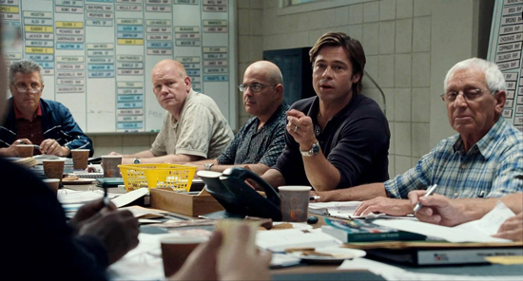
“People… operate with beliefs and biases.
To the extent you can eliminate both and replace them with data,
you gain a clear advantage.”
Michael Lewis | Moneyball: The Art of Winning an Unfair Game
Moneyball (2011)
Notes:
In Moneyball the author writes this:
I think it’s true for our purposes as well
Showing clear, simple and accurate visuals of data
Can provide an advantage for clearer communication

Slide 153
Assign a staff member to regularly review performance measures
Make sure that targets and standards are identified for each measure
Build review of measures into the regular management cycle – monthly staff meetings?
Work with her team to create a simple report that distills and clarifies performance information for management and customers
What should Abigail do?
Notes:
What should Abigail do?
Assign a staff member to regularly review performance measures
Make sure that targets and standards are identified for each measure
Build review of measures into the regular management cycle – monthly staff meetings?
Work with her team to create a simple report that distills and clarifies performance information for management and customers

Slide 154
Review measures on an regular basis and look at historical trends, performance against targets and standards – including benchmarked organizations
Make sure Abigail is prepared for management review sessions
What should Daniel do?
Notes:
What should Daniel do?
Review measures on an regular basis and look at historical trends,
Performance against targets and standards – including benchmarked organizations
Make sure Abigail is prepared for management review sessions

Slide 155
Take a look at the reports and look for explanations for variations in data.
Keep Abigail updated on changes or trends as she notices them
Provide feedback on reports and analysis from the perspective of the customers she works with.
What should Emily do?
Notes:
What should Emily do?
Take a look at the reports and look for explanations for variations in data.
Keep Abigail updated on changes or trends as she notices them
Provide feedback on reports and analysis from the perspective of the customers she works with.

Slide 156
Solid Waste Department
Mission | Solid Waste maintains clean neighborhoods and protects public health by providing solid waste collection, transportation, disposal, compliance and education services at the lowest practical rate and the highest possible customer satisfaction. Key services include: Provide weekly refuse/recycling and monthly brush/bulk collection to residents Provide commercial refuse collection 6 days a week to business and apartments
Expectations | #1 Department personnel must treat residents and businesses as customers #2 Encourage residents and businesses to increase the amount of recycling #3 Scheduled pick-ups must be adhered to in all possible circumstances #4 The department must provide cost-effective services for the citizens
Goal 1 | To provide the highest quality service at the lowest practical rate
Goal 2 | Increase residential recycling diversion rate to 35% or greater by 2020
Goal 3 | To reduce the number of missed collections by 40% by 2015
Goal 4 | 95% of residents will rate department personnel as “excellent” by 2015
Notes:
So here is a final exercise
Read through this information

Slide 157
Performance Summary
Measure | Input | Output | Efficiency | Effectiveness | Link to Goal | Link to Expectations
124,000 tons of garbage collected annually
620 pounds of recyclable material collected per resident per year
$10.8 million expended for equipment and materials
10 commercial users reporting missing collections per 1,000
Average monthly cost of $15.96 per customer for residential service
$6.2 million expended for labor
80,000 households and 1,500 commercial customers
5 household reported missed collections per 10,000 collections
17% diversion rate for material collected
Notes:
And then place check marks in the appropriate columns
We’ll check your work in a moment.

Slide 158
Questions for Discussion:
What historical information would help you better evaluate these measures?
What benchmark information would help the reader evaluate the information?
How could this information be presented to the city council to be as effective as possible?
Notes:
Also think about these questions –
And be prepared to discuss

Slide 159

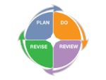
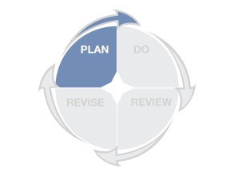
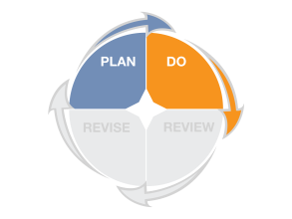
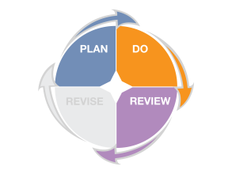
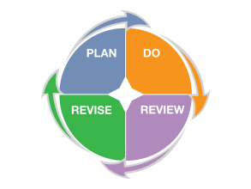
What are we asking you to do?
1. Review services to ensure they are aligned with strategic, council or general plan goals, make adjustments as needed
2. Review existing measures to ensure you are measuring the efficiency, effectiveness, and cost-effectiveness of services and create new measures, if needed
3. Identify standards and targets for each measure to ensure that you have context for evaluating success
4. When measures do not meet identified targets or standards, create and execute a plan to improve performance
Notes:
So what are we asking you to do?
Review existing services/objectives for alignment, make adjustments as needed;
Review existing measures to ensure they measure efficiency, effectiveness, cost-effectiveness – identify new if needed;
identify standards (minimum acceptable levels of performance expected and achieved by high-performing organizations; and standards (specific level of performance you are aiming to achieve given available resources);
When measures don’t meet targets or standards; revise the plan to improve performance
Always empathize with your audience, distill to the key information and clarify the most important information.

Slide 160
Managing
Organizational
Performance
Brent Stockwell
Strategic Initiatives Director
Scottsdale City Manager’s Office
Bstockwell@ScottsdaleAZ.gov
480-312-7288
Notes:
Thank you – we’ll be sending out evaluations via email.
Please provide your honest feedback on how this can improve
I’m here as a resource – let me know how I can help.

